Slide 1
After WW1 and the 1920s

Slide 2
What do you remember?
Define the following:
Imperialism
Triple Alliance (Central Powers)
Stalemate / Battles of Attrition
Battle of Ypres
Lusitania
War Measures Act
Conscription
Victory Bonds
Suffragettes
Armistice
Treaty of Versailles
Reparations

Slide 3
After the Treaty of Versailles
Once the Treaty of Versailles was signed, all of the countries’ delegates went home, but no one was happy
France wanted Germany to pay
The USA wanted more countries to find self-determination
Britain thought that the punishment of Germany was too harsh
German had to sign something taking the blame for the war and promising to pay an undisclosed sum of money

Slide 4
The League of Nations
One promising piece of the Treaty was the creation of the League of Nations (the precursor to the modern-day United Nations). It had 3 main goals:
International Cooperation: countries promised to work together on global issues
Arbitration: Countries promised not to go to war before going through an international dispute process
Collective Security: the members of the League swore to protect any country that found itself as a victim of aggression

Slide 5
The League of Nations (cont’d)
At first, the League was met with optimism, but the reality was that it wouldn’t work because of:
1. It didn’t represent all major nations (the USA decided not to join, Germany and the USSR weren’t allowed to)
2. The League had no army and no power except to sanction countries that violated the covenant. This proved to be fairly ineffective
3. After WW1, there was no taste for war and the major countries of the League (France and Britain) often refused to involve their armies in foreign disputes

Slide 6
1920’s
The Roaring Twenties, The Jazz Age, or an age of downright lunacy

Slide 7
1920’s
Canadians responded positively to the aftermath of the First World War and displayed a new level of optimism by participating in new social activities and expanding the arts and sports in Canada.

Slide 8
Social Changes
Canada also responded positively to the aftermath of the war
Many changes occurred in society
Now that the war was over, people began to feel optimistic once again

Slide 9
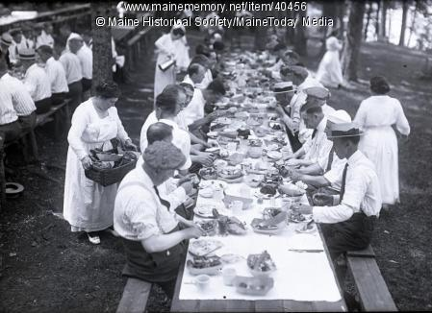
So much room to do activities
Summertime corn roasts, clam bakes, picnics
Horse races

Slide 10
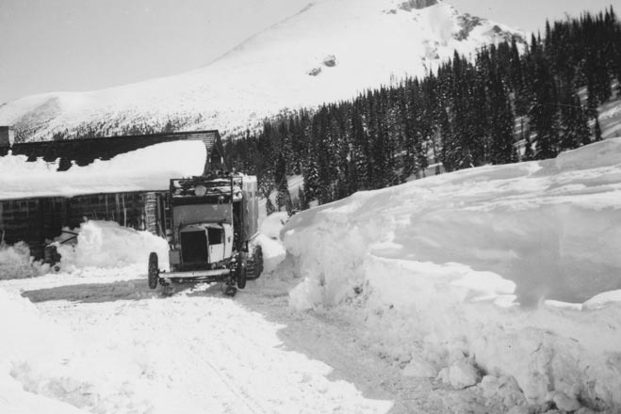
Wintertime
Skating
Skiing
Movies

Slide 11
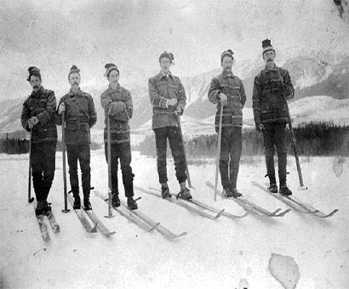
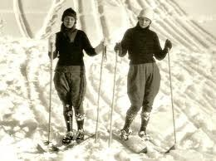
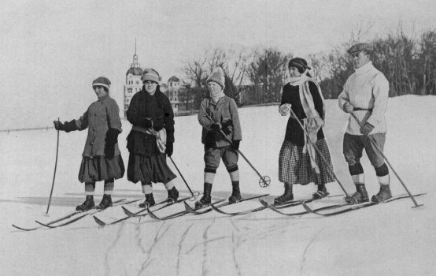
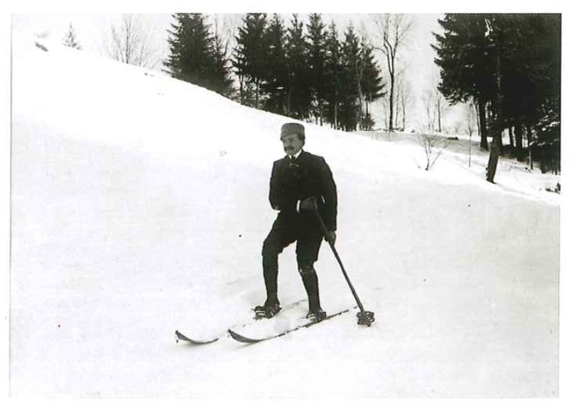

Slide 12
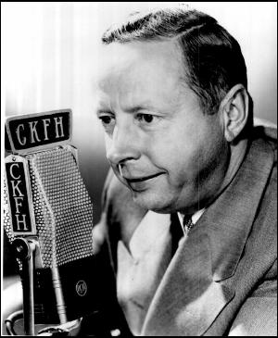
The radio brings hockey home
The radio comes into Canadian homes
“He shoots he scores”
Foster Hewitt
His first broadcast in 1923
Gold in 20, 24, 28
Stanley Cup
Ottawa and Boston
Notes:
Radio was new in the 1920’s but soon everybody started owning a radio and households soon had on
He got his start broadcasting a hockey game between Parkdale and Kitchener Seniors
He sat in a very small both eating a hot dog and began to broadcast the game in his high pitched voice
He was behind glass and it became steamed up so he culd not see who the players were, he said to himself
“Stick it out, kid, it lasts only sixty minutes”
This game went into overtime and lasted 3 hours
This was not the first hockey broadcast though
A man named Pete Parker made the first hockey broadcast nine days before Hewiit did
Canada won the Gold in 1920 beating Swden 27-1
Gold medal won in 1924 was won and outscored opponents 110-3
Ottawa won many Stanley Cups
Boston grabbed one in the late twenties
Canada won gold in 28 and outscored opponents 38-0

Slide 13
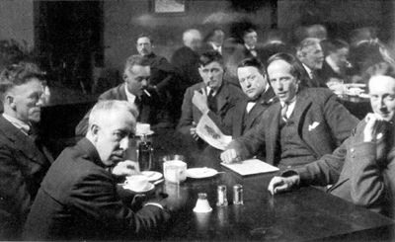
Art
“Group of Seven”
Honed the craft during the war
Rejected realism
Bold strokes, heavy paint, contrast

Slide 14
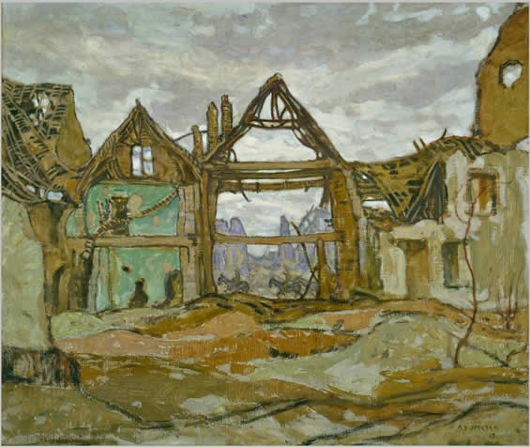

Slide 15
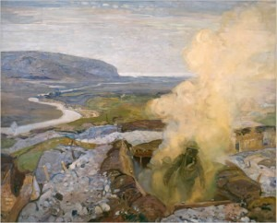

Slide 17
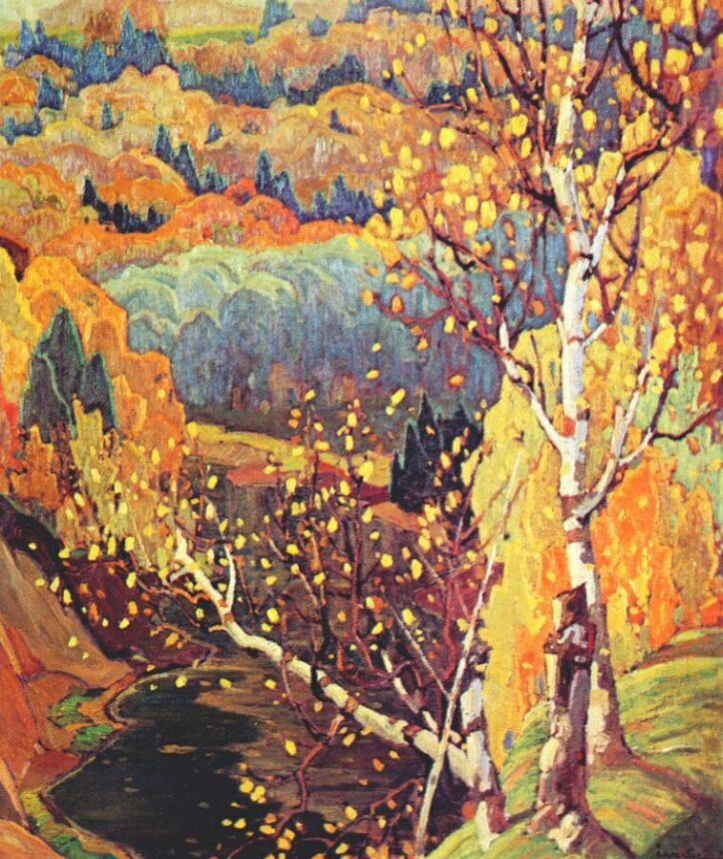

Slide 18
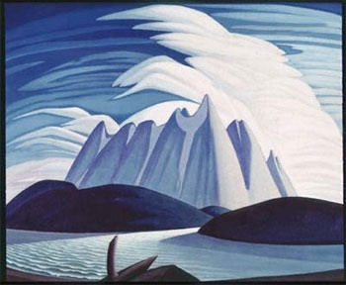
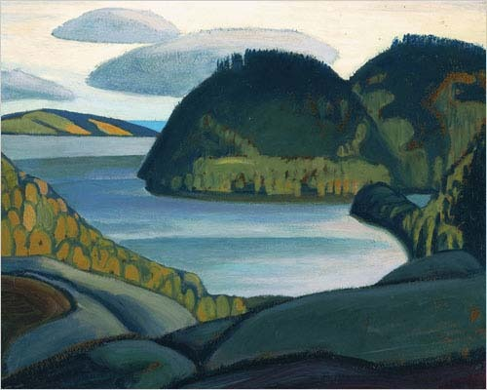
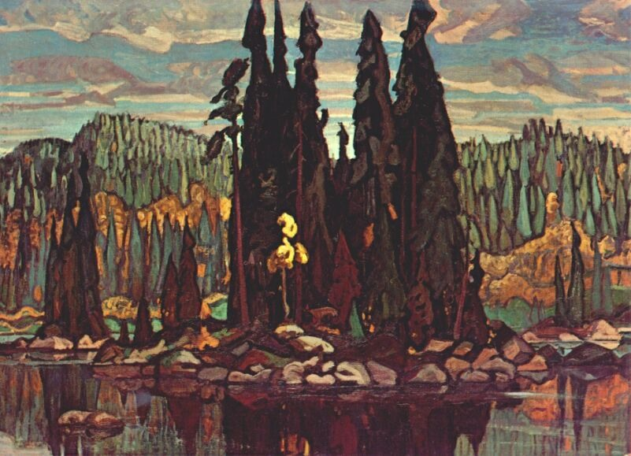

Slide 19
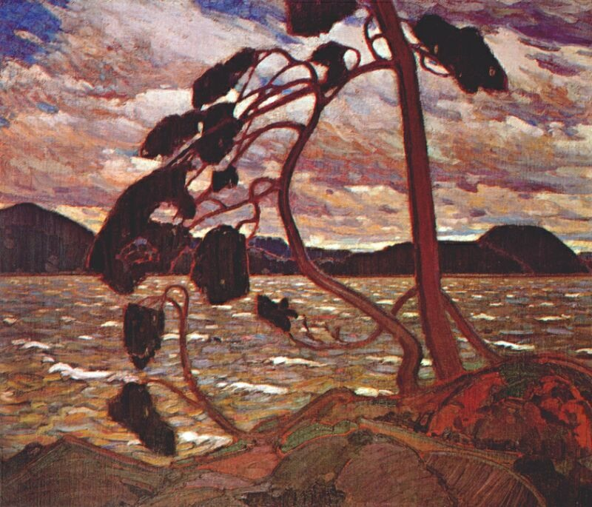
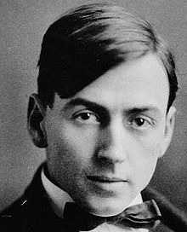
Group of Seven
They only painted landscapes
Tom Thompson

Slide 20
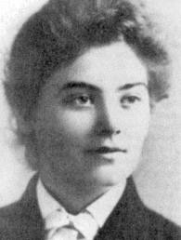
Emily Carr
A painter from Victoria
Painted what she saw around Victoria
Painted landscapes and the aboriginal culture

Slide 21
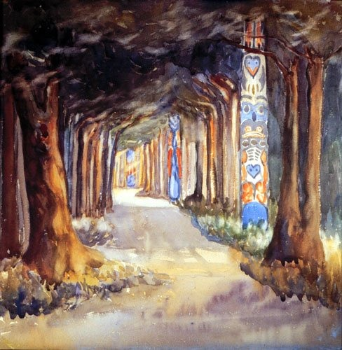

Slide 22
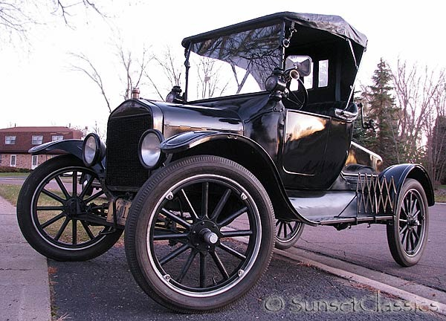
New inventions
The car emerges as a new form of transportation
Airplanes also became more than just weapons in the sky
Notes:
The popularity of the car created new jobs for people
Suburbs also began to be created as people could now drive into the city to work
People could travel farther to visit relatives and to travel to work and vacation

Slide 23
But not everyone was happy…
Some groups didn’t enjoy the 1920s. It is up to you to find out who!

