Slide 1
Origins of Israel
Israel claims to have ancient, pre-Islamic origins
Israel claims ancestry to Kingdom of Israel in Biblical times
Diaspora Jews – Jews were driven from Jerusalem and scattered throughout the Roman Empire; they settled in many parts of Europe & North Africa
Islam began, and spread through military conquest in the 7th century, eventually conquering Jerusalem – a city also important to Muslim myths surrounding Mohammad
Jews have suffered through numerous periods of persecution, including at the hands of Christians during the Crusades
19th century nationalism; Zionism
By the late 19th century most Jews lived in parts of eastern Europe, in isolated communities – i.e. Pale of Settlement in Russia
Zionist movement began in 1800s – desire for Jewish homeland and national self-determination

Slide 2
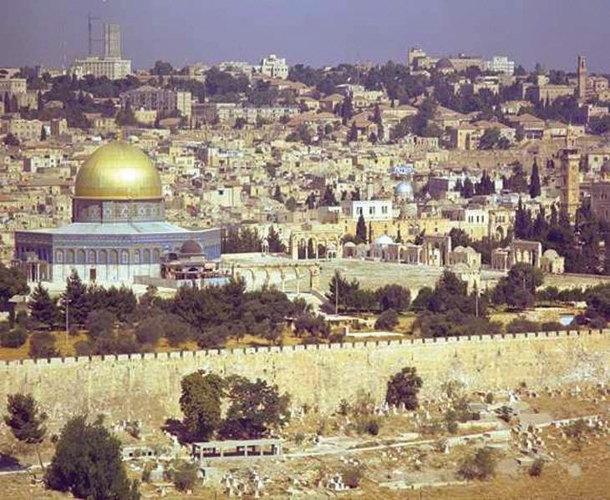
Origins of Israel
Jerusalem is a city that is important to three monotheistic faiths: Christianity, Judaism & Islam
The Dome of the Rock, an Islamic Mosque was built over a Jewish & Christian holy site

Slide 3
Origins of Israel
The Middle East has always been a zone of conflict, but the seeds of modern conflict were born with the creation of Israel in 1948
Jewish settlers made their way in small numbers to the Holy Land – they later became the nation of Israel
Settlement started in 19th century; continued during early to mid-1900s
Persecuted Jews made their way to America, but many came to the Holy Land (Palestine) to establish farming communes (kibbutz)
First World War & Arab Revolt – British made conflicting promises concerning Palestine
Hussein-McMahon Correspondence – promised Arab independence in Palestine in return for aid against the Turks
Sykes-Picot Agreement – British and French to divide Ottoman Empire
Balfour Declaration – promised Zionist homeland in Palestine

Slide 4
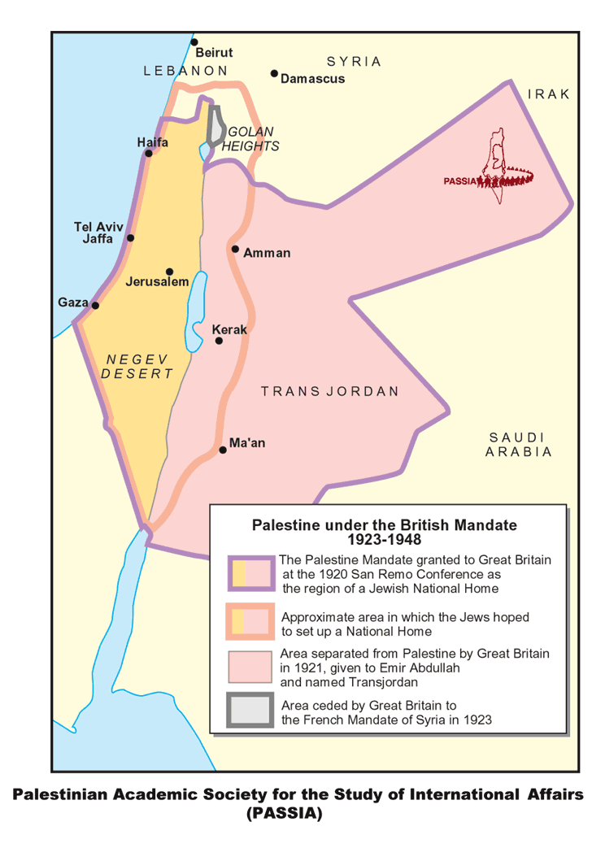
Origins of Israel

Slide 5
Origins of Israel
Mandate Period - Palestine was made a League of Nations mandate under British control in the Sevres Treaty (1919)
Jewish settlement increased during the Mandate period, bringing some conflict with Muslim Palestinians in the region
Palestinians rioted and committed acts of violence against Jews in the region – the Jews created Haganah (paramilitary force); Lehi & Irgun ; thought British Army offered unreliable protection
The British tried to cap Zionist immigration after the White Paper (1939) recommended restrictions – Jews responded with acts of terrorism against British troops
Holocaust & World War II
Arabs officially neutral; some rose in revolt – Jews fought for Allies
Holocaust convinced international community of need for Jewish homeland
Zionist lobbyists argued stronger for creation of Israel; thousands of European refugees flooded into Palestine

Slide 6
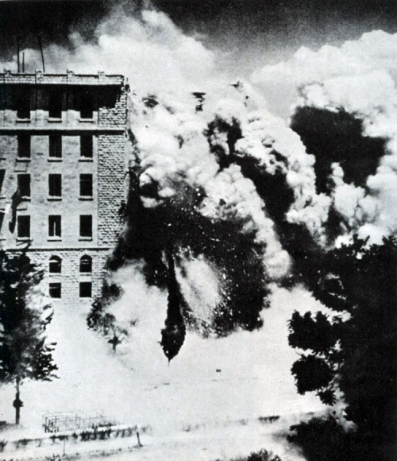
Origins of Israel
(1947) end of the British Mandate; United Nations Special Committee for Palestine (UNSCOP)
After WWII, Britain could not settle disputes between Jews and Arabs & decided to withdraw
1947: UNSCOP came to conclusion of equal validity of Arab & Jewish claims; only viable solution was partition into 2 states in accordance with existed settlement patterns & population centres
Irgun bombing of King David Hotel, 1946

Slide 7
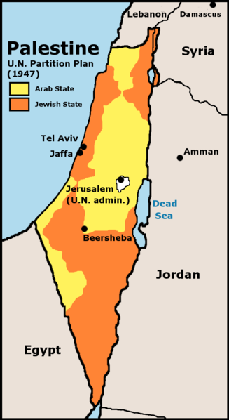
Origins of Israel
In 1947, the United Nations created a dual state with a partition of Palestinian and Jewish regions
Partition was flawed
Expectation that 2 states form single economic unit
Many Arabs still resided in Jewish areas
Territorial fragmentation; not easily defensible; communication & travel difficult
The city of Jerusalem was also divided, but placed under UN administration

Slide 8
Origins of Israel
The state of Israel was opposed by the Arab League
Jews did not like partition, but David Ben Gurion accepted it as first step toward statehood
Palestinians did not like partition plan
Neighbouring Arab states (Arab League) decided to go to war to prevent creation of the state of Israel
UN General Assembly voted in favour of the plan; skirmishes broke out between Jews & Arabs in lead up to end of UN mandate – i.e. massacre at Deir Yassin (250 Arab dead)
May 14, 1948 – state of Israel proclaimed sparks chain of events & a regional war
USA & USSR recognize the new state – both wanted to expand sphere of influence into the Middle East
Egypt, Jordan, Syria and Iran invade Israel

Slide 9
1948 War
FILM CLIP: Fifty Years War (Proclamation of State of Israel, 1948 war)
The controversy surrounding 1948 War is apparent in the names given to the first Arab-Israeli War
Israelis: “War of Independence”
Arabs: “Palestine War”
Palestinians: “the disaster” (an-Nakba)
The war is controversial because of its outcomes:
Arab defeat against smaller Israeli forces
Creation of a massive unsolved refugee problem – 550,000 to 800,000 refugees
War lasted from 30 Nov 1947 to June 1948 - Arabs scored early victories but lost
disunity, lack of coordination, no common goals – most states seeking self-interest; Israelis fighting for survival

Slide 10
1948 War
June 11, 1948 “truce” was turning point
Israeli Defense Forces (IDF) able to establish numerical superiority in troop numbers; imported weapons from Czechs despite UN arms embargo
Acquiring weapons helped shift momentum toward Israelis – went on offensive
Plan D (Dalet) – Israelis developed early strategy of pacifying villages on key transportation arteries
Resulted in depopulation or occupation of villages
Controversial document used as evidence (Ilan Pappé) of deliberate plan to commit ethnic cleansing in Palestine
others claim (Benny Morris) there was no deliberate strategy
In some cases Palestinians voluntarily left their homes

Slide 11
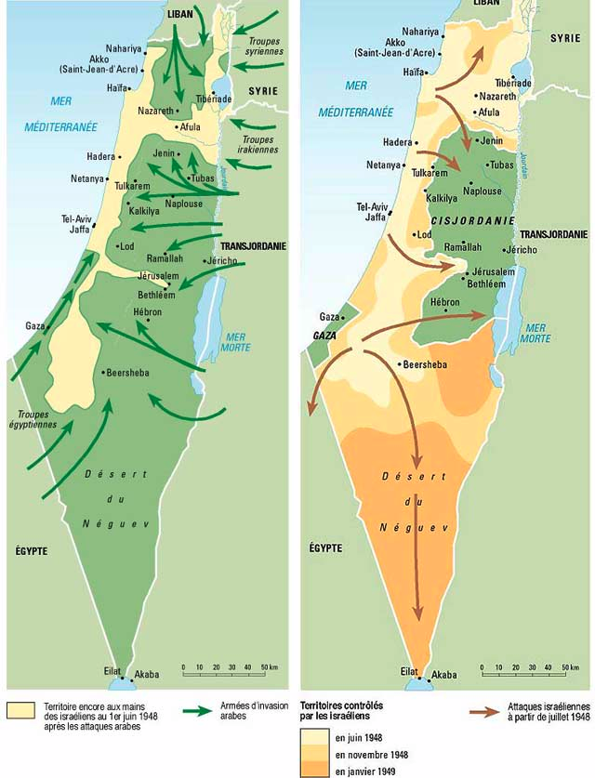
1948 War
The initial Arab assault made progress (left)
Israeli counter-attacks in June-July 1948 reversed the course of the war (right)

Slide 12
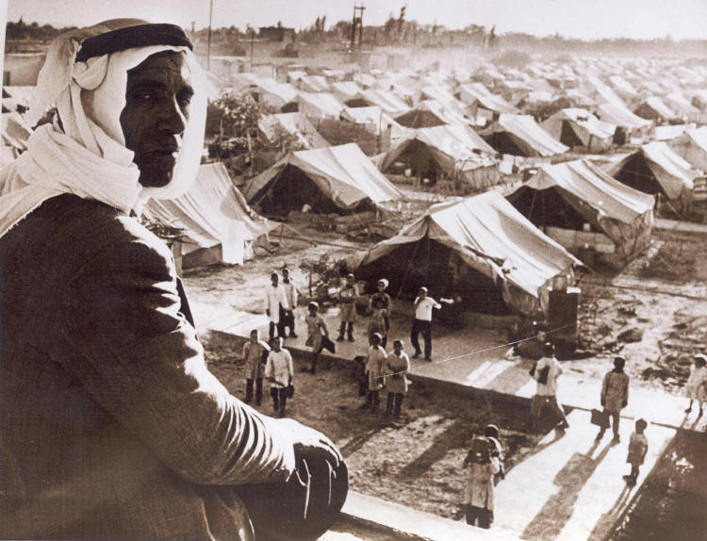
1948 War
A Palestinian refugee camp after the 1948 War.
Many Palestinians today claim the “right of return” to their homes.
Most refugees were temporarily housed in camps in Jordan, Syria, Egypt and Lebanon

Slide 13
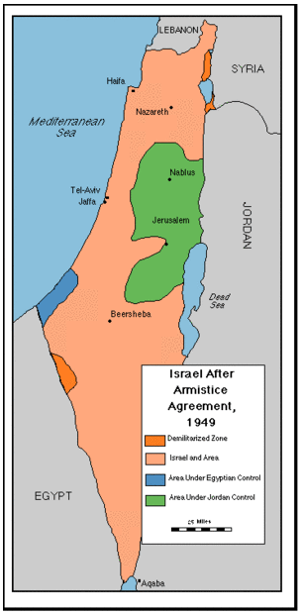
1948 War
Armistice reached in Jan, 1949 but no peace settlement
Israel increased territory & now held more defensible positions;
Arab states (Egypt; Jordan; Syria) also increased territory
550,000-800,000 Palestinian refugees temporarily settled
Other parts of Middle East depopulated of Jews, who settled in former-Palestinian villages and towns
Indecisiveness of the war ensured there would be renewed fighting soon
Notes:
Compare this map to the one of Israel under the UNSCOP partition plan

