Slide 1
Free Officers Coup (Egypt 1956)
Humiliation of defeat destabilized Arab regimes
Led to coups and assassinations in Jordan, Lebanon & Syria
July 1952, Colonel Gamal Abdel Nasser helped lead military coup of Egypt’s King Farouk – became leader in 1954
Nasser pursued a policy of non-alignment to USA or USSR to achieve position of leadership for Egypt in the Middle East
Originally, seen as positive development in Israel and the USA – was preferable to Muslim nationalists (Wafd) who pressured for war
1955 – Nasser refused to join Baghdad Pact (US alliance in Middle East)
Nasser was intensely nationalistic
Desired to improve irrigation and modernize Egypt by building a dam on the Nile (Aswan High Dam) – USA withdrew funding from Egypt
Signed arms deal with Czechs to get modern military equipment (1955)
Notes:
American funding was withdrawn from Nasser when it became obvious he would not align with the USA – this was a mistake as it opened the door for the Soviets to support Nasser

Slide 2
Suez Crisis (1956)
Tensions between Egypt and Israel deteriorated
Border clashes & raids were common - Islamic fedayeen raids across the border were common in 1950s
Egypt closed the Straits of Tiran (Red Sea) & Suez Canal to Israeli shipping
Israel conducted raids into Arab states against refugee camps where terrorist attacks were organized
Czech arms deal – led to Israelis planning pre-emptive strike
July 1956 – Nasser nationalized the Suez Canal
Angered British – deprived investors of profits
French annoyed at Nasser’s support of Arab guerillas in Algeria
Suez nationalization provided Israel, French and British with common enemy and reason for war – US not consulted
October 1956 – Israel struck at Sinai and seized canal
British and French troops landed at Suez and bombed economic targets in Egypt
Notes:
In Israel, debate raged between Moshe Sharett’s conciliatory response to Nasser and ben Gurion’s demand for pre-emptive action – ben Gurion’s view won out

Slide 3
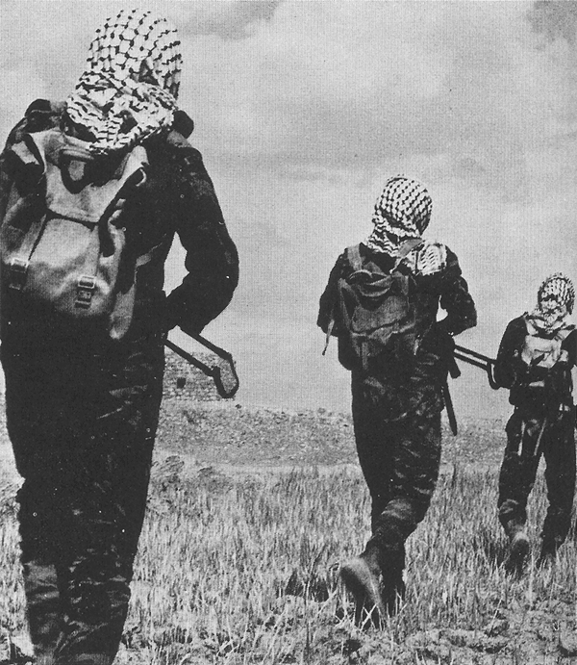
Suez Crisis (1956)
Fedayeen – “freedom fighters” were terrorists to Israel
Border raids from Arab states increased regional tensions in the 20th century and destabilized the Arab states who could not control them
Fedayeen helped create the Palestinian identity as a nation without their home – in reality, before 1948 there was not really a Palestinian people
There were no such things as Palestinians [in 1948]. It was not as though there were a Palestinian people and we came and threw them out and took their country away from them. They did not exist… - Golda Meir, Israeli PM
Notes:
Fedayeen helped shake the myth taught in Israel that Palestine had been “a land without a people” before the Israelis arrived

Slide 4
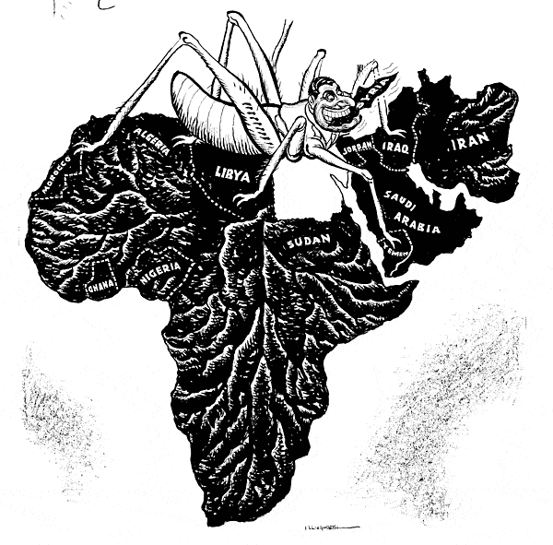
Suez Crisis (1956)
“Pan Arabism?” - Nasser was depicted in the west as a tyrant bent on regional domination – was this accurate?
Anthony Eden, British PM, compared Nasser to Hitler and argued Munich-style appeasement shouldn’t be repeated

Slide 5
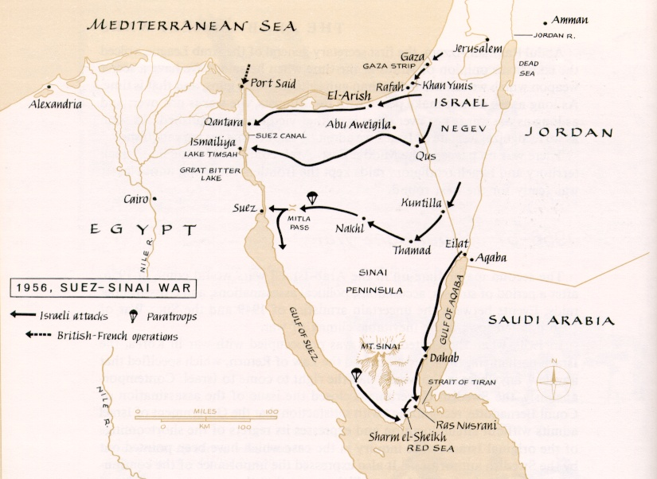
Suez Crisis (1956)
Israel swiftly defeated Egyptian defenses in the Sinai

Slide 6
Suez Crisis (1956)
UN sanctioned embargo placed on Israel & resolution demanding troops withdraw
Britain and France were losers
End of international relevance as major powers
Both forced to withdraw by US – Khrushchev threatened nuclear war
US wanted withdrawal because of own interests
Israel and Egypt were winners
UNEF peacekeeping force provided buffer zone between Israel and Egypt – protected Israel from feyadeen attacks
UNEF guaranteed access to Red Sea
UNEF guaranteed Egyptian control of Suez
Nasser appeared to have challenged European imperialists and won
Israel proved themselves in a very effective military campaign
Notes:
Eisenhower and Dulles wanted the British and French out because:
They feared it would bring Soviets into regional conflict
Eisenhower was in the middle of election campaign – was campaigning as a peace candidate
US feared disruption to oil interests
US was too involved in Hungarian Uprising – had condemned Soviets for invading Hungary, could not then go and support Br-Fr/Israelis invasion of Egypt

Slide 7
Pan Arabism
After 1956, new groups emerged to carry out guerilla warfare and terror attacks on Israel – El Fatah
El Fatah carried out attacks from bases in Syria, Jordan, Lebanon
Syria government controlled after 1963 by secular Baath Party – were supporters of Pan-Arabism
Syria’s Baathist government shelled Israeli settlements from the Golan Heights – tensions between Syria and Israel reached a high in 1967
Pan-Arabism was a secular movement for Arab unity against Israel
Was socialist in outlook; anti-western and anti-imperialist
Nasser emerged as the leader of the movement
United Arab Republic formed in 1958 (Egypt, Syria and Iraq) – but fell apart in 1971
Israel felt increasingly threatened by 1967 – led to regional arms race
Notes:
It was at the height of Pan-Arabism that Israel developed nuclear weapons – Israel has never signed the NPT (Non-Proliferation Treaty) which restricts new countries from developing nuclear weapons, because it has never fully admitted they possess a nuclear arsenal
Today Israel is determined to ensure its Arab and Iranian neighbours never acquire nuclear weapons

Slide 8
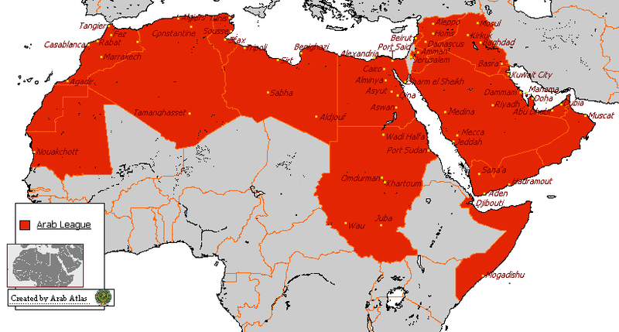
Pan-Arabism
Arab unity was centred on common hatred of Israel

Slide 9
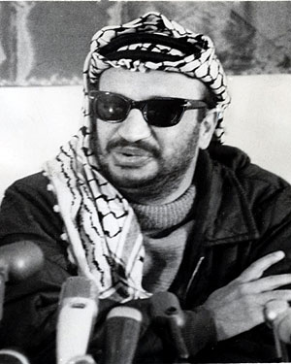
Palestinian Liberation Organization
In order to control Palestinian guerillas operating inside Arab states, Nasser created the PLO
PLO declared its aims to claim Palestine as a future state and to use violence to achieve that goal
Until 1967, PLO under Arab control – even trained the PLA (Palestinian Liberation Army)
El Fatah leaders took over the PLO
Palestinians came to believe Arab states not interested in liberating Palestine from Israeli occupation
Yassir Arafat emerged as a leader of Fatah

Slide 10
Six Day War (1967)
By 1967, paranoia and insecurity in Israel
Increasing Syrian & Egyptian rhetoric and threats
Increasing feyadeen & terrorist attacks
Militant Baathist Party came to power in Syria (1966)
There is some controversy over why the 1967 war started and who was responsible
Soviets gave incorrect report to Egypt – claimed Israel mobilizing for war
Soviets may have wanted crisis to draw in US (currently having troubles in Vietnam)
Nasser asked for UN withdrawal of UNEF peacekeeping force in 1966 – was under pressure from militants in Arab states to act against Israel
Nasser closed the Straits of Tiran – Israel interpreted this as act of war
Israel PM Levi Eshkol forced to give Defense Ministry to Moshe Dayan who wanted first strike against Arabs

Slide 11
Six Day War (1967)
The Six Day War was a decisive rout by Israeli Defense Forces (IDF) over their Arab enemies
IAF destroyed Arab planes on the ground and eliminated tanks
Sinai Peninsula was retaken and occupied
West Bank and East Jerusalem captured from Jordan
Golan Heights seized from Syria
Egypt lost 10,000 troops; Israel 766
Israel retained gained territory as bargaining chip for peace or for buffer zone against enemies
US supported Israel through arms supplies – this increased Cold War tensions
Soviets threatened war and sent ships to Mediterranean to shadow US navy
US came to see Israel as valuable ally against Soviet influence in Arab states

Slide 12
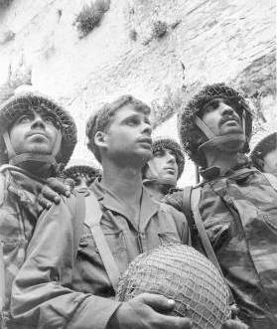
Six Day War (1967)
IDF soldiers at the Wailing Wall in Jerusalem after its capture, and taking a swim in the Suez Canal

Slide 13
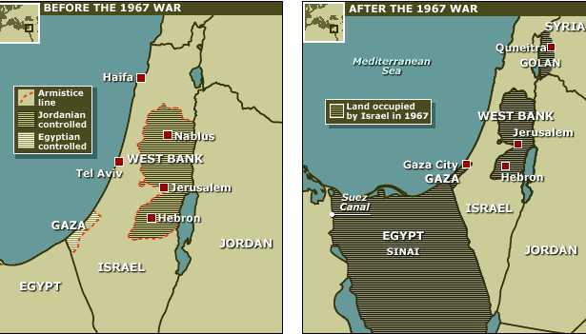
Six Day War (1967)
Israel added substantial territory and many non-Israelis to its state in 1967

Slide 14
Six Day War (1967)
Results
Victory in 1967 relieved tensions in Israel, though fighting continued
Approx. 325,000 more refugees, but many Palestinians remained in “Occupied Territories” creating new problems for Israel
War of Attrition with Egypt (1968-69) – border skirmishes
UN Security Council passed Resolution 242
Declared territory acquired through war was invalid
Declared right of people to live in peace, within their own borders free from acts of force
return of pre-1967 borders & “just settlement” of the refugee problem
War resulted in ending Pan-Arabism movement
Islamic militancy increasingly became the solution in many people’s minds to the Palestinian Question
Notes:
Historian Benny Morris argues that since 1967 the issue of “right of return” and “just settlement” of the refugee problem has plagued attempts at lasting settlement – he argues Ben Gurion should have gone farther in expelling non-Israelis in 1948

Slide 15
PLO, Black September
FILM LINK: Arafat and PLO
FILM LINK: Spielberg’s film “Munich”
“Black September” (1970)
To control increasingly militant Palestinians in Jordan, King Hussein crushed an uprising killing 3000
Israel sent troops to help King Hussein drive PLO out of Jordan
Palestinians ended up in refugee camps in Lebanon
Increasing terrorist attacks and hijackings carried out by groups with PLO or Fatah links after 1967
Most notorious was “Munich Massacre” in 1972 Olympic Games in Germany where 11 Israeli athletes were killed
Mossad (Israeli Secret Service) carried out reprisal assassinations
Arafat comes to see that terrorism is not likely to solve problems – seeks diplomacy
Efforts to moderate his strategy causes new more militant and extreme factions to form
CBC FILM LINK: 1972 Munich Massacre
Notes:
Mossad and Gold Meir the Israeli PM argued that it was necessary to kill Fatah leaders or others with links to terrorism in order to prevent further attacks

Slide 16
Yom Kippur War (1970)
Anwar Sadat became Egypt’s president in 1970
Believed conflict not advantageous to Egyptians, but could not permit Israelis to settle in the Occupied Territories
Did not think Egypt could continue to afford arms race with Israel; made them too dependent on Soviets
Tried to negotiate Israel’s withdrawal – Israel would not without recognition of right to exist
Sadat knew Egypt would lose another war with Israel, yet launched surprise attack in 1973
USA crippled by Watergate and Vietnam
Believed USA and USSR could not afford either side to have a complete victory – their intervention was inevitable
Believed superpowers would intervene and force Israel to negotiate
Syria joined because new leader (Asad) needed to prove himself

Slide 17
Yom Kippur War (1973)
Arab armies attacked during Jewish holiday (Yom Kippur) – was a surprise – “October War” begins
Israel underestimated frustration felt over occupation of Golan Heights, Sinai, Gaza and West Bank
Israeli Defense Forces came close to defeat in first few days, but recovered even though outnumbered 12:1
Massive US military aid sent to Israel to prevent collapse
By the second week, IDF drove Arab forces back – the USA and USSR imposed cease-fire through UN Resolution 338
USSR threatened to send an army to relieve the Egyptian army – confrontation with USA was plausible
The expense of the war caused economic crisis in Israel – they needed US financial aid to stay afloat; now more willing to negotiate peace
Notes:
Some evidence that Israel knew of attack, but did nothing – Golda Meir argues in memoirs that Israel could not afford another pre-emptive strike because international sympathies would side with Arabs and they needed allies

Slide 18
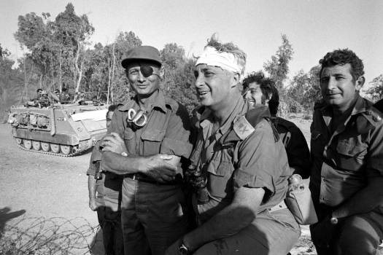
Yom Kippur War (1973)
Southern commander Ariel Sharon (bandaged) became the hero of the war when his bold counterattacks cut Egyptian troops off from their supplies.

Slide 19
Yom Kippur War (1973)
OPEC crisis (1973-74)
Arab states opposed to US support of Israel imposed an embargo on North America and Europe
The embargo caused an energy crisis of shortages and high prices that crippled the economy
US benefited in some ways from the October War
High oil profits for oil companies; high prices made western deposits of oil more profitable
Secretary of State, Henry Kissinger worked to bring about negotiations between Israelis and Arabs

Slide 20
The peace process
Politically the Arabs won the 1973 war, though were defeated militarily
Sadat emerged as a cool, calculated statesman
First war in which Israel suffered high casualties – led to political anger against the government
Far right parties emerged in Israel; Israel was in political and economic turmoil and in more willing position to negotiate
Menachem Begin (Likud Party) elected in 1977
Marked a change in Israeli government for first time since 1948
Sadat went to Israel in 1977, laid out terms for peace
Egypt granted access to Suez; Israel to withdraw from Sinai
Israel would not relinquish Golan Heights, West Bank or include Palestinians at the negotiations – this led to deadlock in peace process

Slide 21
The peace process
The Carter administration was able to facilitate peace between Sadat and Begin
Camp David Accords in 1978 resulted in:
Egypt-Israeli Peace Treaty (signed 1979)
Israel traded land for peace – Sinai returned to Egypt
Egypt became first Arab state to formally recognize Israel
Israel continued to occupy the Gaza Strip
“Framework for Peace in the Middle East” based on UN Resolutions 242 and 338 – resolution of Palestinian refugee problem & self-government for Palestinians in Gaza Strip and West Bank

Slide 22
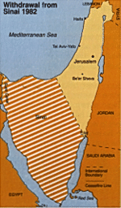
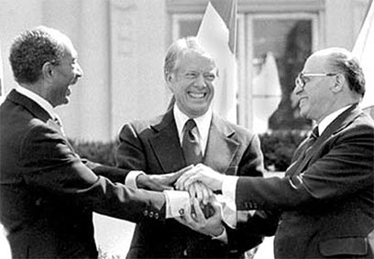
The peace process
The Israel-Egypt Peace treaty was signed by Sadat, Begin & Carter – the US gave Israel guarantees that it be kept
The flaw in the treaty was failure to include Palestinians in negotiations – uprisings and terror attacks continued

Slide 23
The peace process
1979 was a turbulent year in the Middle East – Islamic Revolution in Iran
Peace was not accepted by all in Egypt and Israel, and especially among Palestinians
Begin faced opposition from far right parties
Sadat was assassinated by Islamic extremists
Uprisings in Gaza, the West Bank and Lebanon Many Palestinians hampered the peace process or stood in the way of Sadat’s attempts to resolve the Palestinian question
PLO created the Palestinian National Authority
Sought to gain recognition of a Palestinian government; Arafat feared West Bank and Gaza being turned over to King Hussein’s government in Jordan
In 1974 at the Rabat Conference the PLO was declared to represent the Palestinian people

Slide 24
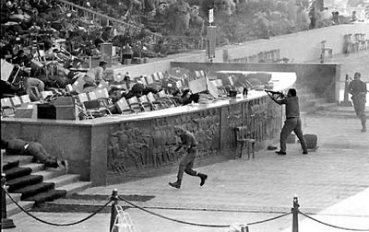
The peace process
FILM LINK: Assassination of Sadat
Militant extremists in the Arab world felt betrayed by Sadat’s peace settlement with Israel – he was shot in 1981

Slide 25
Lebanon War (1975-85)
Peace was elusive between Israelis and Palestinians after the Egypt-Israeli peace
Civil war broke out in Lebanon in 1975 between different factions, including Muslims and Christians
The PLO backed the Muslim factions in the civil war hoping they would overthrow the government
Syria also intervened against the Lebanese Christians (Phalangists)
PLO guerillas used southern Lebanon to attack Israel
Israeli forces invaded in 1978 to push PLO out of southern Lebanon and support Phalangists
UN attempts to send peacekeepers failed; Israeli attacks went on for three years
Beirut and much of southern Lebanon was destroyed in intense fighting

Slide 26
Lebanon War (1975-85)
UN negotiated ceasefire in 1981 – Lebanon was by now in anarchy and violent disarray
June 1982 – Israelis launched full-scale military invasion to destroy PLO refugee camps in Lebanon
Conventional assaults failed to dislodge guerillas from Beirut, so Israel resorted to mass bombing raids
Sabra and Shatila Massacre (1982)
Israeli forces helped (may have participated) in Phalangists militia entering Palestinian refugee camps in Beirut
Approx. 700-3000 Palestinians were killed
Led to renewed efforts of international community to restore stability

Slide 27
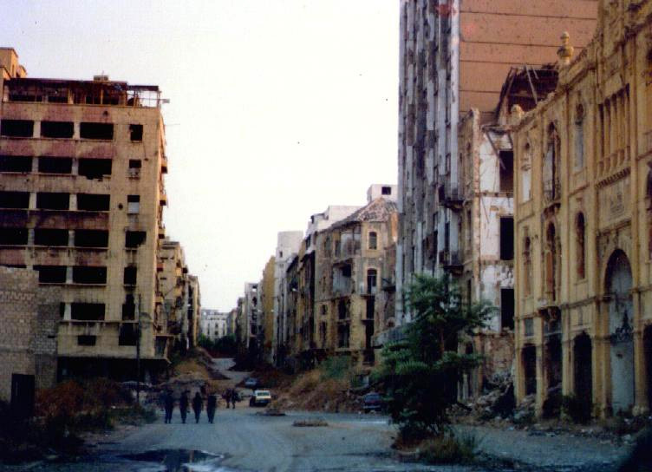
Lebanon War (1975-85)
The ruins of Beirut, once a popular tourist attraction (1982)

Slide 28
Lebanon War (1975-85)
International peace efforts failed
The civil war drew in several militant groups and anti-Israeli states such as Iran
The militant Islamic terrorist group Hezbollah was formed during the conflict
Suicide bombings targeted US personnel sent to Lebanon
1983 Marine barracks bombing killed 241 Americans – US later withdrew
Israeli forces withdrew in 1983
Israeli intervention was indecisive and did not produce results – it shattered the myth of Israeli’s invincible military
Anti-war demonstrations appeared in Israel for the first time
Notes:
Bombing of US servicemen was likely in retaliation for US support of Lebanese Army against Islamic factions in the civil war
Israel withdrew; however PLO also withdrew under US supervision

Slide 29
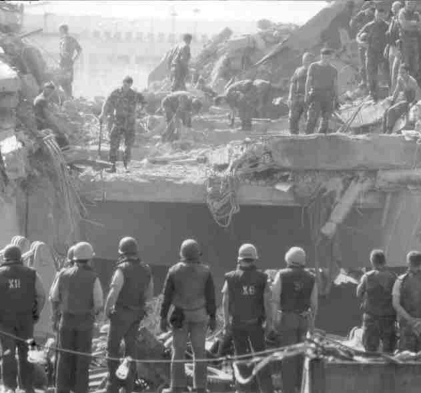
Lebanon War (1975-85)
US troops search remains of bombed barracks (1983)
Notes:
Bombing of US servicemen was likely in retaliation for US support of Lebanese Army against Islamic factions in the civil war
Israel withdrew; however PLO also withdrew under US supervision

