Slide 1
Intifada
The problems of the “Occupied Territories” were not solved
Political opposition pressured Israeli government to allow Jewish settlers to build new villages in West Bank and Gaza
The first “Intifada” uprising broke out in 1987
Palestinians rioted, attacked Israeli troops and blockaded streets in Gaza and West Bank – Israeli Defense Forces responded with violence
The intifada interfered with peace talks between Israel and PLO – Arafat offered a “gun and and olive branch”
Further peace initiatives have failed since 1980s
There have been repeated intifada uprisings and Israeli reprisals
Terror attacks continue
Hezbollah and Hamas claim to represent Palestinians but are dedicated to destroying Israel; the PLO has been discredited
Israeli settlers continue to occupy villages in the Palestinian lands

Slide 2
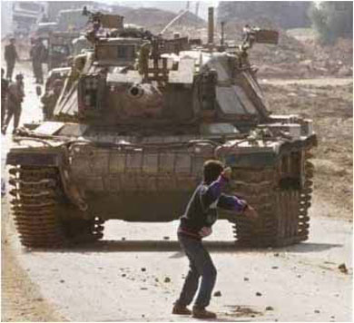
Intifada
Palestinians often confront Israeli troops with primitive weapons

Slide 3
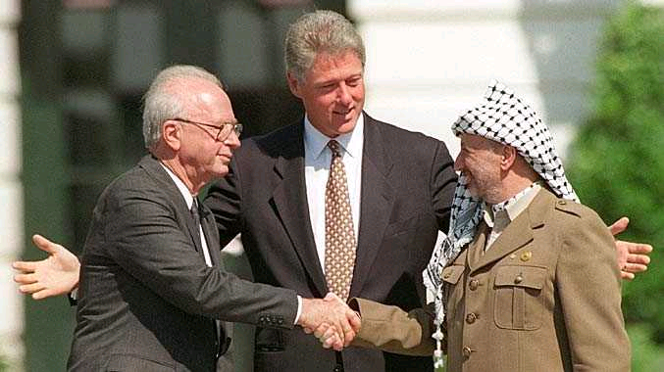
Oslo Accords 1993
Yitzhak Rabin, Clinton, Yasser Arafat
1993 – Oslo Accords – Yitzhak Rabin and Yasser Arafat agree to plan for Palestinian governance of some parts of West Bank and Gaza.

Slide 4
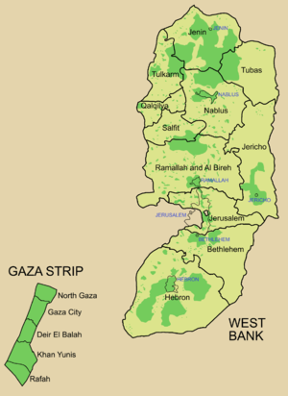
The Palestinian Authority
1993-Creation of Palestinian Authority. Arafat allowed to return to occupied territory.
1996 – Arafat and Fatah party become head of Palestinian Authority in first ever Palestinian elections.
2000 – attempts to resolve Palestinian sovereignty break down. Neither Ehud Barak nor Yasser Arafat can agree to a plan.
Palestinian Territories

Slide 5
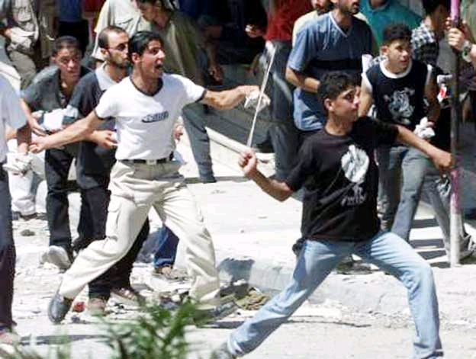
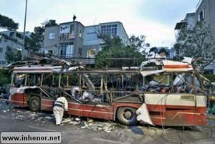
The Second Intifada, 2000-Present

Slide 6
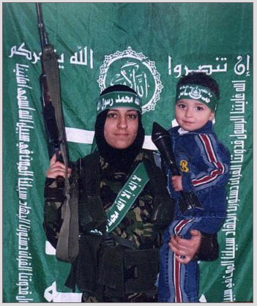
Al-Aqsa Martyrs Brigade
Hamas - Islamic Resistance Movement “Zeal”

Slide 7
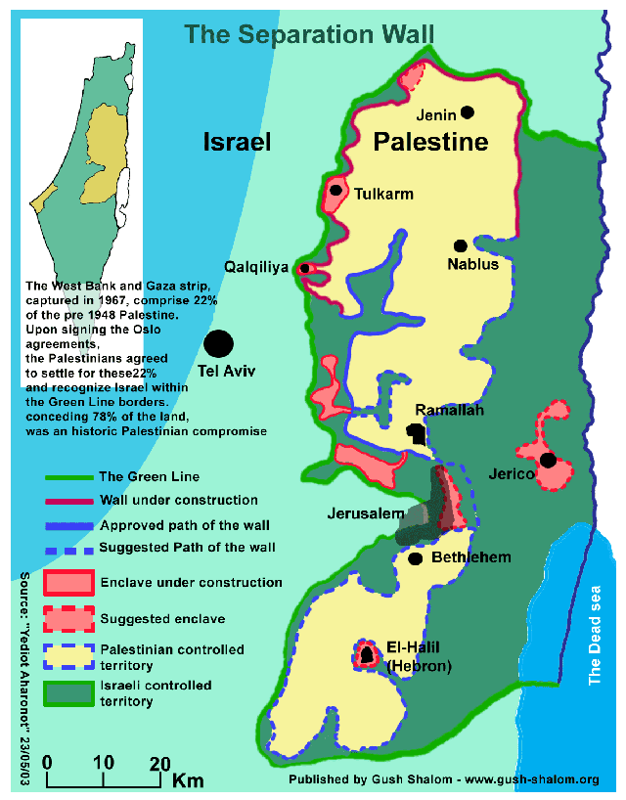
2001 – Ariel Sharon assumes power in Israel – Palestinian Authority looses control to Israeli security forces in West Bank and Gaza.
2003- Israel begins construction of security wall in Palestinian territories despite international condemnation.

Slide 8
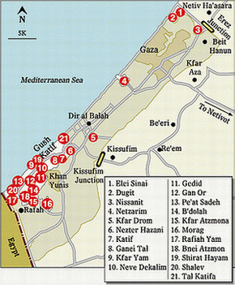
2004- Sharon withdraws Israeli soldiers from Gaza Strip. Forces removal of nearly 20,000 Israeli settlers from Gaza.

Slide 9
Recent Developments
2004 – Yasser Arafat dies. Mahmoud Abbas assumes
control over Palestinian Authority in 2005 elections.
2006 – Hamas wins majority of parliamentary seats in Palestinian elections. United States cuts aid to Palestinians in response.
2006- Ehud Olmert elected prime minister after Sharon suffers stroke.
June 2006 – Israeli warships accused of killing Palestinian family on Gaza beach. Hamas kidnaps Israeli soldiers. Hezbollah begins firing rockets into Israel from Lebanon. Israel responds with air-strikes on Hezbollah and eventually entering southern Lebanon.

Slide 10
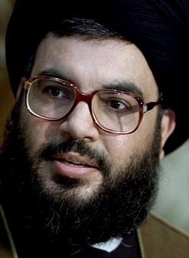
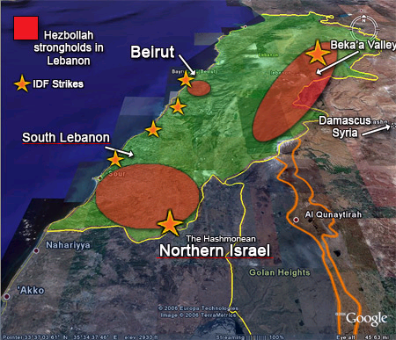
Hezbollah Control of Southern Lebanon
Hezbollah Leader
Hassan Nasrallah
2006 Lebanon War

Slide 11
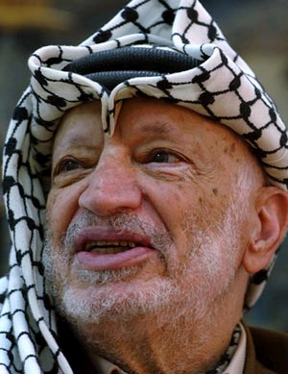
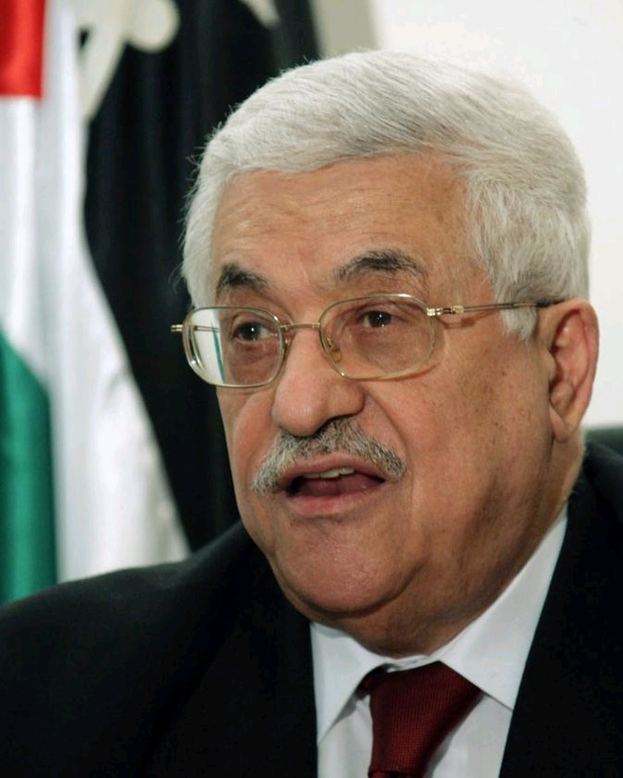
Palestinian Authority Leadership
Yasser Arafat (1996-2004)
Fatah
Mahmoud Abbas(2004-Present)
Fatah

Slide 12
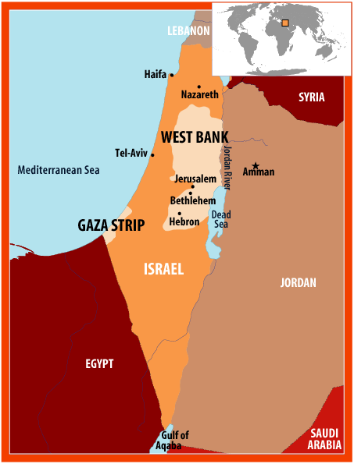
Hamas derives most support from Gaza strip.
Fatah has most of its support in the West Bank.
Since 2006, President Abbas has attempted to oust and replace Haniyeh as prime minister.
At present, the Palestinian authority is effectively divided.

Slide 13
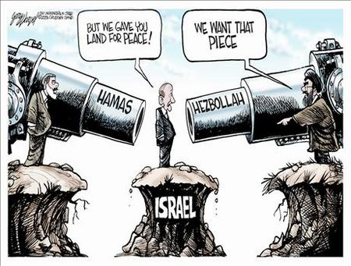
The Arab-Israeli Conflict Today
Hezbollah refuses to recognize Israel’s right to exist.

Slide 14
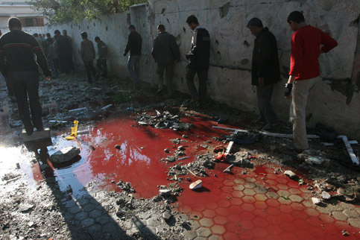
The Arab-Israeli Conflict Today
Palestinians pass by a pool of blood after the Israeli shelling of a residential area in Beit Hanoun in the northern of Gaza Strip in which at least 18 people were killed, 8 November 2006

Slide 15
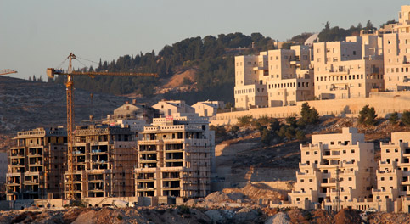
The Arab-Israeli Conflict Today
An obstacle to peace? Israel continues to build settlements in the “occupied territories” on the West Bank.

Slide 16
What obstacles to peace remain?
Refugee problem and “right of return”
One state or two state solution?
East Jerusalem – Israel wants it as a capital, never divided; Palestinians say it is their future capital
Regional states have not made peace with Israel – Iran and Syria
Israel refuses to accede to UN Resolution 242 – will not relinquish territory won in war
Orthodox and militant Jews refuse to leave occupied territories
PLO and Hamas – somewhat reasonable – were defeated in elections by the militant Hesbollah factions
Military force alone has been indecisive in settling the main issues
FILM LINK: BBC Panorama: “Walk in the Park”

