Slide 1
What is the Demographic Transition Model (DTM)?
The demographic transition model explains the transformation of countries from having high birth and death rates to low birth and death rates.
In developed countries this transition began in the 18th century and continues today.
Less developed countries began the transition later and many are still in earlier stages of the model.

Slide 2
Demographic Transition Model
Make a copy of the DTM on the sheets provided
Make sure you add appropriate labels/detail.

Slide 3
Stage 1
Birth Rate and Death rate are both high. Population growth is slow and fluctuating.
Birth Rate is high because of:
Lack of family planning
High Infant Mortality Rate: putting babies in the 'bank'
Need for workers in agriculture
Religious beliefs
Children as economic assets
Death Rate is high because of:
High levels of disease
Famine
Lack of clean water and sanitation
Lack of health care
War
Competition for food from predators such as rats
Lack of education
Typical of Britain in the 18th century and the Least Economically Developed Countries (LEDC's) today.

Slide 4
Stage Two
Birth Rate remains high. Death Rate is falling. Population begins to rise steadily.
Death Rate is falling as a result of:
Improved health care (e.g. Smallpox Vaccine)
Improved Hygiene (Water for drinking boiled)
Improved sanitation
Improved food production and storage
Improved transport for food
Decreased Infant Mortality Rates
Typical of Britain in 19th century; Bangladesh; Nigeria

Slide 5
Stage Three
Birth Rate starts to fall. Death Rate continues to fall. Population rising.
Reasons behind birth and death rate falling:
Family planning available
Lower Infant Mortality Rate
Increased mechanization reduces need for workers
Increased standard of living
Changing status of women
Typical of Britain in late 19th and early 20th century;
China; Brazil

Slide 6
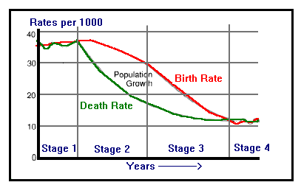
Stage Four
Birth Rate is low.
Death Rate is low.
Population steady.
Typical of USA; Sweden; Japan; Britain

Slide 7
Stage Five
Typical of Germany
Birth Rate slight fall.
Death Rate stable.
Natural increase: gentle decrease
Reasons for changes in birth rate:
Family planning
Better health
Later marriages
Improved status of women
Reasons for changes in death rate:
Good health care
Reliable food supply
People are generally living longer

