Slide 1
Failed decolonization of Rwanda
Based on the article by Jan Zahorik

Slide 2
Background
Rwanda is a small land-locked nation in Africa with a population of about 12 million (2020)
Historical records begin with a Tutsi king in 1860

Slide 3
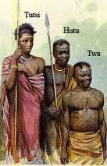
Groups in Rwanda
Before the colonial period there were three distinct ethnic peoples living in the Rwandan region: the Hutu, Tutsi, and Twa
The Hutus first settled in Central Africa between 500 and 1000 BCE. They were largely agricultural people
The Tutsis were nomadic people arriving in the region about 400 years ago. They were largely cattle-herders
The Twa people were indigenous to the land and lived largely in the hilled-regions of the country. They were largely hunters.

Slide 4
Relations
The Hutu population of Rwanda has always been the largest, today making up 85% of the population
The Tutsi are about 14% of the population
The Twa make up only 1%
When the groups first started to live together, Hutus and Tutsis blended ethnicities, sharing culture and language
As time went on, because of Tutsi knowledge for keeping cattle created greater wealth, they were able to take control quickly of the larger population of Hutus in the country

Slide 5
Was this social or ethnic difference?
In a 1996 interview with Charlayne Hunter Gault, Professor Izangola explained:
“In Rwanda, the Tutsi and the Hutu are the same people. They are all people–large grouping or communities which go from seven regions of Cameroon to Uganda–all the way to South Africa, in the same culture,” Izangola said. “People used to be Tutsi or Hutu, depending on the proximity to the king. If you were close to the king, you owned wealth, you owned a lot of cattle, you are a Tutsi. If you are far away from the king, you are a cultivator, you don’t own much cattle, you are a Hutu.”

Slide 6
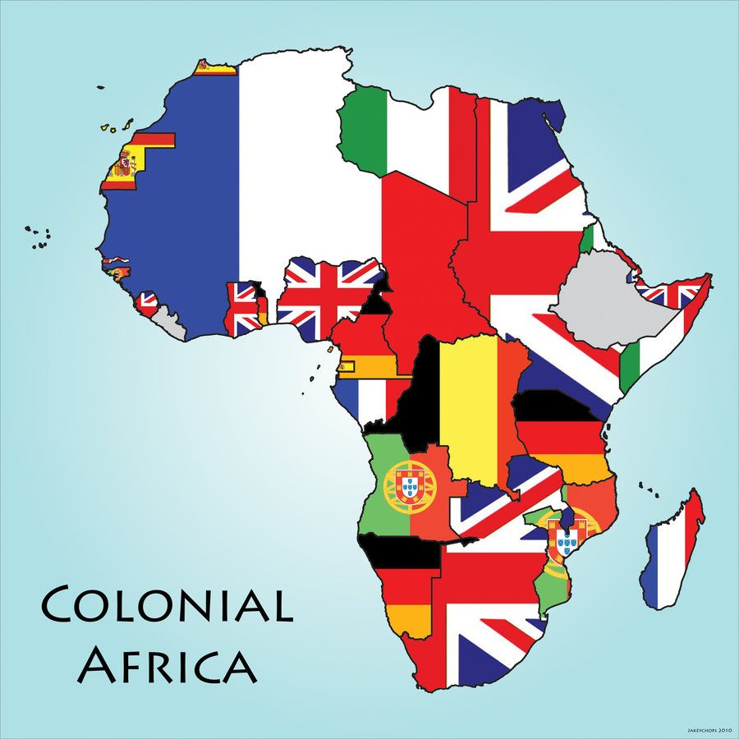
Colonization of Africa
The 1800s consisted of what came to be known as the “Scramble for Africa” – a race to colonize the continent of Africa by European nations
Africa provided a source of cheap labor, raw materials and new markets for these countries, which were going through the Industrial Revolution.
These colonizing powers, however, began to compete with each other over control.

Slide 7
Berlin Conference of 1884
In 1884, leaders from 14 colonial powers, including the US, Belgium, Portugal, Germany and Spain, held the Berlin Conference where they divided the continent of Africa into 50 countries and claimed them for themselves.
These divisions were made arbitrarily and without any consideration of the common culture, history and language shared by different groups of African people.
As a result, two things occurred: people of common ethnic groups were separated by arbitrary national borders and warring ethnic groups were brought under the same government.
The map of Africa remains largely the same as when it was divided in 1884 - a major source for many of the continent’s conflicts today.

Slide 8
Under the Belgians
First a German colony, after WW1, the League of Nations gave it to Belgium to administer under the name "Ruanda-Urundi"
When the Belgians entered, they saw a hierarchy of control and used it to aid their own administration
The already powerful Tutsi was put in charge of "ruling" the country with the backing of the Europeans; the Hutus and Twa were treated as second-class citizens with no privileges
Until WW2, the Tutsis enjoyed greater social privileges including more wealth, access to education, and greater power and influence within the nation

Slide 9
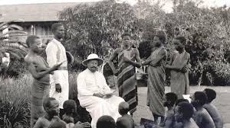
Pre-colonial institutions
Two pre-colonial institutions established under the Tutsis were exploited by the Belgian colonialists:
  Uburetwa was a tax system that was imposed on Hutus only as a mandated contribution to national development
  Ubuhake was a system of patronage where a Tutsi could take on a vassal, or someone poorer than them to work as a servant
The Belgians used this hierarchy to create dependency from one group on another and ultimately dependency on the imperialist government
Notes:
Not slavery as this was a chosen role (as much as can be chosen when you are in need of money)

Slide 10
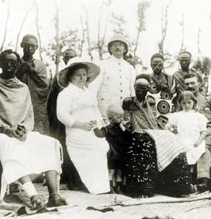
Exploitation by the Belgians
In pre-colonial Rwanda, chiefs were largely ceremonial, but under the Belgians they were given greater control and power causing a split between those with power and privilege (the Tutsis) and those categorized as labour force (the Hutus)
Previously while chiefs were always Tutsis, both Hutus and Tutsis were subordinate. Now, under the Belgians, this was delineated no longer by social difference but by ethic difference

Slide 11
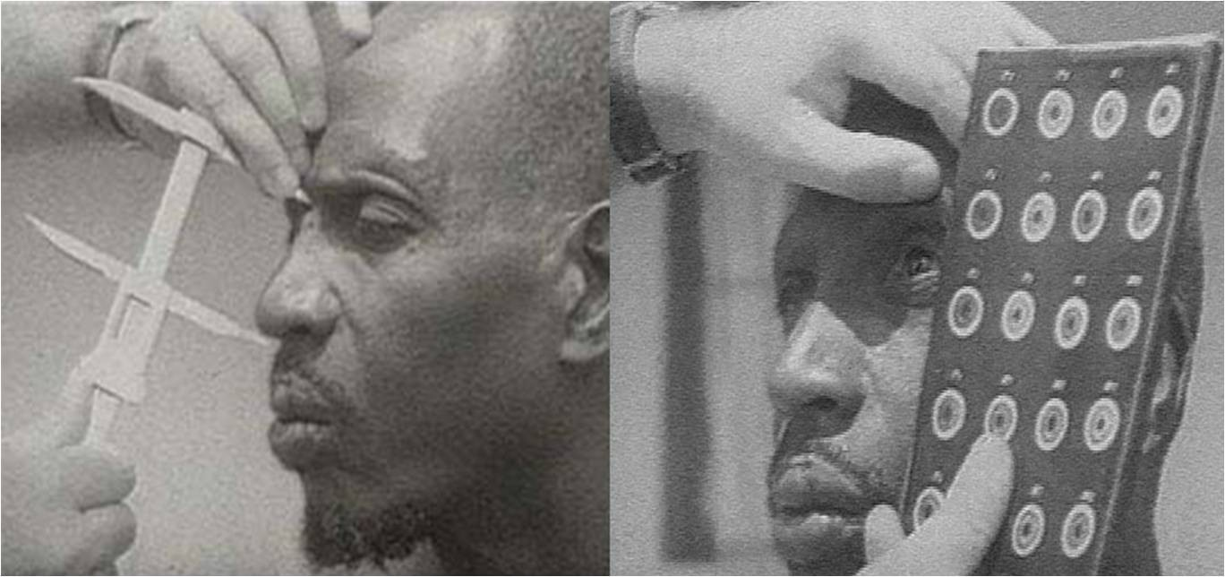
Racial classification
The Belgian colonists divided Rwanda’s unified population into three distinct groups: Hutu, Tutsi, and Twa.
In order to do this, the colonists created a strict system of racial classification. Both the Belgians and the Germans, influenced by racist ideas, thought that the Tutsi were a superior group because they were more “white” looking.

Slide 12
Time goes on...
Into the 1930s and 40s the divide between Hutu and Tutsi widens.
Tutsis have greater access to education systems and therefore have more options available to them
Those people classified as Hutu were meant to become workers and taxpayers

Slide 13
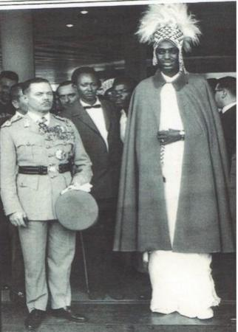
Tensions worsen
The Hutus, who make up about 85% of Rwanda’s population, were denied higher education, land ownership and positions in government. By the 1950s, their resentment had grown.
Tutsis, who were in power, also began to feel resentment. They resented the colonial rule of the Belgians and wanted to be even more independent. After World War II, Tutsi elites grew impatient and became more aggressive in their pursuit of independence.
The Belgians feared that their colonial rule was coming to an end. Some colonial rulers felt that by favoring the Hutu and trying to take back some power from the Tutsi, they could remain in power longer.

Slide 14
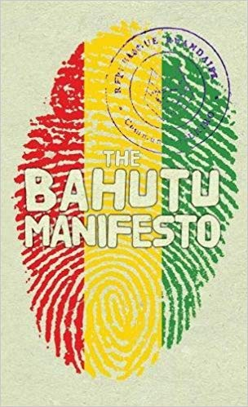
Hutu Manifesto
Stating that the Hutu were first colonized by the Tutsi and then by the Europeans, in 1957 the Hutu Manifesto was released in hopes that it would promote and develop Hutus and remove Tutsis from power
It blamed the Tutsis for having socioeconomic and cultural monopolies
It was aimed at both Belgian authorities and the United Nations in a bid to achieve post-war emancipation and self-determination

Slide 15
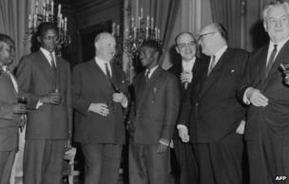
Independence and Hutu Rule
In 1959, violence between the Tutsi and Hutu erupted. Hutus overthrew Tutsi rule, declared an independent republic and elected the first Hutu president, Greg wa Kayabanda. Mass killings of Tutsis occurred during the transition to Hutu rule, hinting at things to come.
The Hutu-led government used the same system of racial oppression that existed during colonialism, except that now they were in control.
Even though the Hutus had suffered from this identity classification, they kept it in order to use it against the Tutsi who had once used it against them.

Slide 16
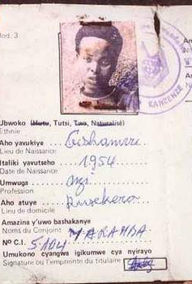
Decolonization
As many colonial powers were leaving Africa after WW2, they implemented the idea of "Africanization" that allowed for native development and democratization
The Hutu Social Movement, established in 1957, used this as an opportunity to gain more rights and power
The Tutsi elites rejected the Hutu demands by pointing at "historically approved" myths concerning racial superiority

Slide 17
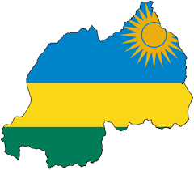
Political Parties
As democratization began, political parties were formed:
  UNAR (L'union Nationale Ruandaise) wanted to preserve the monarchy
  RADER (Rassemblement Democratique Ruandais) wanted to reach social economic and cultural order
Tensions continued to rise and violent clashes ensued.
By 1960 the death toll on both sides was 20,000

Slide 18
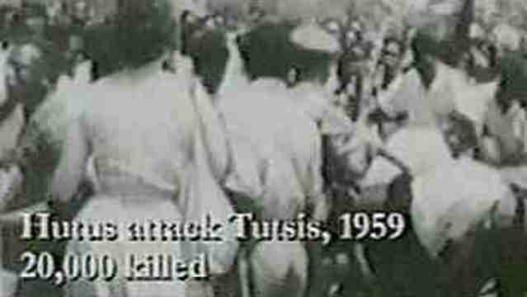
Hutu Revolution
Violent clashes continued and many Tutsis sought refugee status in neighbouring Uganda
On January 28, 1961 3126 representatives of Hutu power assembled in the capital city of Kigali seizing control of government
A UN Commission report stated:
  "Racial dictatorship of one party was established in Rwanda and the development of the last 18 months leaned on transition from one type of oppressive regime to another."

Slide 19
Independent Rwanda
Ruanda-Urundi split into two countries: Rwanda and Burundi
In Burundi, the Tutsis have maintained power until today
Established in 1962, the Belgian colonists officially left Rwanda with the Hutu rebels in power
Tens of thousands of Tutsis had to flee to neighbouring Uganda

Slide 20

Activities in Uganda
When Yoweri Museveni, a rebel leader of Tutsi descent, seized power in Uganda in 1986, it was largely through the assistance of Rwandan Tutsis.
With a power base in Uganda, the Rwandan Tutsis formed the Rwandan Patriotic Front and began attacks against the Hutu-led government.
Tensions between Hutus and Tutsis in Rwanda increase to all-time highs

Slide 21
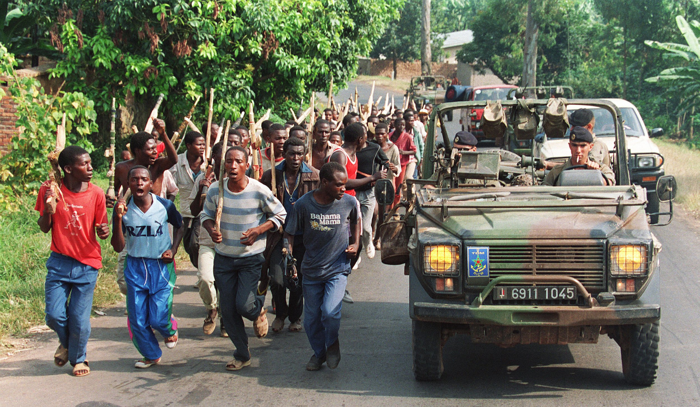
Preparation
Hutu officials began preparation to carry out a massive genocide of the Tutsi minority.
They trained and armed militias and gave arms to civilians.
They distributed lists of people who were to be targeted and killed. Messages of hate were broadcast over the radio, encouraging the killing of Tutsi and opponents to the Hutu regime.
The messages portrayed Tutsis as evil cockroaches and rats.

Slide 22
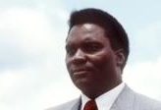
Death of the President
At the encouragement of the United Nations, Rwandan President Habyarimana was brokering peace talks with the Rwandan Patriotic Front
The night Habyarimana returned home from negotiations his plane was shot down near Kigali Airport. The President’s own supporters, Hutu extremists, are believed to have orchestrated the attack in order to prevent the President from signing peace agreements although the exact circumstances have never been determined.

Slide 23
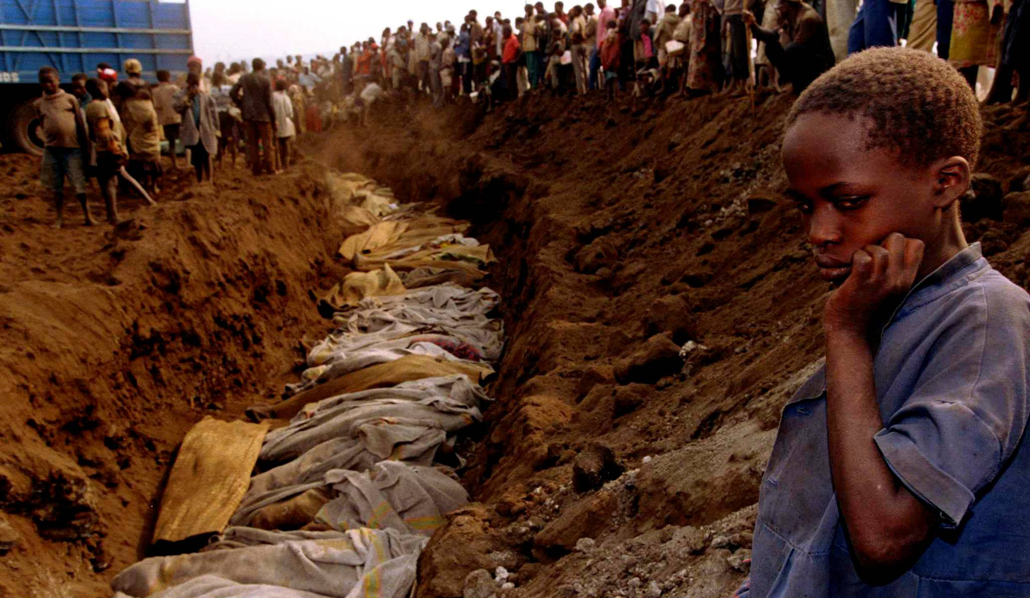
Genocide
After years of fighting, the Rwandan government launched a genocidal campaign against Tutsis living in Rwanda in 1994.
According to reports, over 800,000 people were slaughtered over a period of 100 days.
Eventually, the tide turned against the Hutus and the Rwanda Patriotic Front defeated the Rwandan Army, forcing hundreds of thousands to flee, mostly to Tanzania and Zaire.

Slide 24
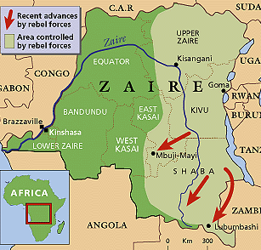
Post-Genocide
From refugee camps in Zaire, Hutus continued the fighting by launching cross-border raids on Tutsis and moderate Hutus living in Rwanda and Uganda.
When Zaire’s government, led by President Mobuto, was unable or unwilling to assert control over his eastern frontier, the Tutsi governments of Uganda, Rwanda and Burundi backed a rebellion that toppled the state.
The rebel leader they supported, Laurent Kabila, renamed Zaire the Democratic Republic of the Congo.
When the Hutu raids continued, the Tutsi-led states encouraged a second rebellion against Kabila.

Slide 25
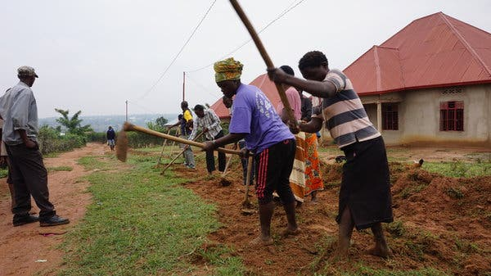
Reconciliation
In order to rebuild together the Rwandan government taken steps to try to heal and move forward. These include:
  Creating a National Unity and Reconciliation Commission
  Banning genocidal ideology
  A mandatory community service where every able-bodied Rwandan from age 18 to 65 must take part in public works projects in their communities
Notes:
Many political analysts and human rights groups say Mr. Kagame has created a nation that is orderly but repressive. Laws banning so-called genocidal ideology that were adopted to deter a resurgence of sectarian or hate speech are also used to squelch even legitimate criticism of the government.

Slide 26
Works cited
"The Heart of the Hutu-Tutsi Conflict." PBS News Hour, PBS, 8 Oct. 1999, www.pbs.org/newshour/politics/africa-july-dec99-rwanda_10-08. Accessed 29 Jan. 2020.
Hynowitz, S., and A. Parker. "History of genocide with pictures." American University Washington College of Law Center for Human Rights and Humanitarian Law., www.WCLCenterforHR.org.
Specia, M. "How a Nation Reconciles after Genocide Killed Nearly a Million People." New York Times, 25 Apr. 2017, www.nytimes.com/2017/04/25/world/africa/rwandans-carry-on-side-by-side-two-decades-after-genocide.html. Accessed 29 Jan. 2020.
Zahorik, J. "Some Notes on the Failed Decolonization of Rwanda." WBHR, Feb. 2012, dspace5.zcu.cz/bitstream/11025/11403/1/Zahorik.pdf. Accessed 29 Jan. 2020.

