Slide 1
Underlying and immediate causes of WWI
“Fear, hunger and pride” Liddell Hart

Slide 2
Militarism & the arms race
Germany builds the world’s second most powerful navy, a direct challenge to Britain. In 1897, the Kaiser said, “the trident must be in our fist.”
Mandatory military service (conscription) in most European countries (Britain had no large field army)
Gunboat diplomacy: Agadir, Morocco in 1911.

Slide 3
Br & Fr. had agreed to the French control of Morocco at the Algeciras Conference.
Germany sends the gunboat Panther to Agadir to protect its economic interests and its citizens.
Germany agrees to leave when the other European powers agree to give it territory in the Congo

Slide 4
Imperialism
Most of the world divided up by the European powers- constant friction that might escalate into war
War and conflict seen as “a game”
Germany arrives late to the game after its unification in 1870 and aggressively pursues it “share”
This causes friction with Britain and France
Berlin to Baghdad railway builds German influence in Turkey
Germany had supported the Boers of Transvaal during the Boer War

Slide 5
Nationalism & self-determination
Austria-Hungary annexes Bosnia and Herzegovina in 1908
A-H had controlled it since 1879
Serbia wanted to add it to “Yugoslavia”
Russia supports Serbia as a fellow “Slavic” state

Slide 6
Nationalism & self-determination con’t
b. Minorities in Russia and Austria-Hungary wanted independence; the governments of each saw war and expansion as a “safety valve” by diverting energy against an external foe
c. German socialism and the growing demand for the vote made the German government see war as a unifying outlet for unrest as well

Slide 7
Alliance Systems
The Triple Alliance- the Central Powers
Germany with Austria-Hungary in 1879
Ger. & A-H with Italy in 1882

Slide 8
Alliance Systems
b. The Triple Entente- the Allies
France with Russia in 1891
Britain with France the “Entente Cordiale” 1904
Britain with Russia 1907

Slide 9
Rival War Plans
war by timetable- once mobilization was ordered the military takes over
In Germany the Schlieffen Plan
in a two front war France must be defeated first (6 weeks) then Russia
Belgium must be invaded in order for the “right wing” of the German armies to encircle the French armies
The war would be over before Britain’s resources could become a factor

Slide 10
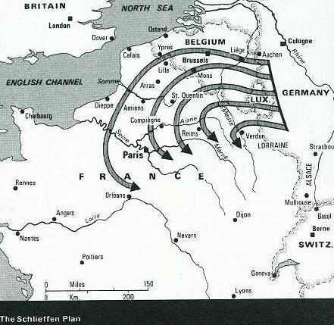
The Schlieffen Plan

Slide 11
Schlieffen said:
“Let the last man on the right brush the Channel with his sleeve.”
And on his deathbed:
“It must come to a fight. Only keep the right wing strong.”

Slide 12
Rival War Plans con’t
In France Plan 17
“Elan Vital” the all conquering spirit, the belief in the offensive at any cost
cut the German army in two at the centre

Slide 13
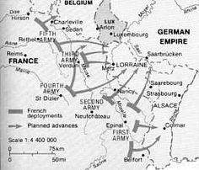
France Plan 17

Slide 14
Rival War Plans con’t
b. “Home before the leaves fall.”
The country’s resources, men, supplies and transport only required for a quick war
Each new offensive was to produce a breakthrough that would end the war

Slide 15
Von Moltke, hero of the 1870 war with France, said the next European conflict:
“will be a national war which will not be settled by a decisive battle but by a long wearisome struggle with a country that will not be overcome until its whole national force is broken, and a war which will utterly exhaust our own people, even if we are victorious.”

