Slide 1
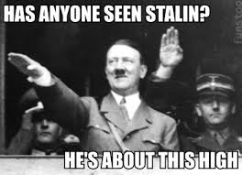
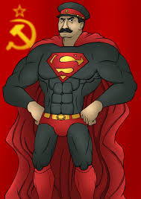
Eastern Front: Another of Hitler’s Mistakes
Don’t Mess With Uncle Joe

Slide 2
Background Events:
The USSR attacked Finland “Winter War”.
Italy invades Greece but were soon forced back into Albania.
Significance: Yugoslavia disappeared from the map as Hitler had to come to Mussolini’s rescue

Slide 3
Barbarossa – “Red Beard”
Goals:
1. Invasion of Russia (surprise attack)
2. Destruction of communism – war of extermination
3. Grab for Lebensraum (more living space)
Statistics: 8,000,000 men engaged in a battle of titanic proportions.
Length of Front: 2000 miles long
153-200 German divisions initially attacked the USSR
A total of 3 million German soldiers would fight in the east
German motorized divisions advanced 50 miles on the 1st day (200-300 miles in the first week)

Slide 4
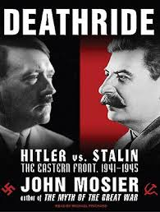
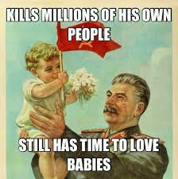

Slide 5
Germany Successes in the 1st 6 months
Leningrad: Dec 1941Hitler’s armies surrounded its 3,000,000 inhabitants cut off by the Germans. People suffer from hunger; thousands die every day of starvation and the intense cold.
KIEV (UKRAINE)
KHARKOV (WEST OF STALINGRAD)
SMOLENSK (WEST OF MOSCOW):
USSR’s Economic Base: 60% of Russian coal and pig-iron production (over ½ the out-put of steel)

Slide 6
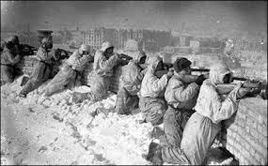
The Problem W/Russia
Autumn Rains and ‘General Winter’:
-coldest winter in ½ a century
-dirt roads became quagmire bogging down machines and men
-soldiers froze to death
Stalin’s ‘Scorched Earth’ Policy: Russians poison wells, slaughter livestock, crops in flames. They wanted to make sure that the Germans had no food or shelter.

Slide 7
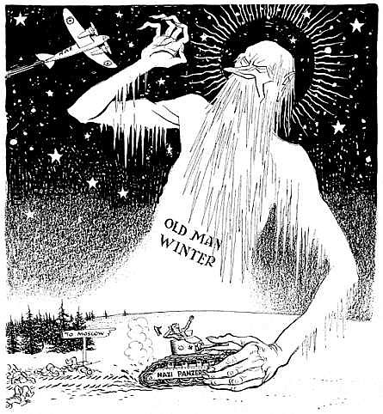

Slide 8
Horrible Histories – Stalingrad Stores
http://www.youtube.com/watch?v=OUX7mAeeF04

Slide 9
Russian Counter-Attack
MOSCOW: the Russian winter halted the Germans – they smashed into Russian barbed wire and trenches dug by civilians near the city
TECHNOLOGY: amasses new tanks – T34 tanks – wide tracks, excellent reliability
SOVIET RESERVES: 100 Soviet divisions
GERMAN DEAD: 1,000,000 (Soviet losses 3x that number)

Slide 10
Spring 1942 – A New Plan
-2 pronged attack:
i) 6th Army to take Stalingrad
ii) Army Group A to take the oil rich area of the Caucasus

Slide 11
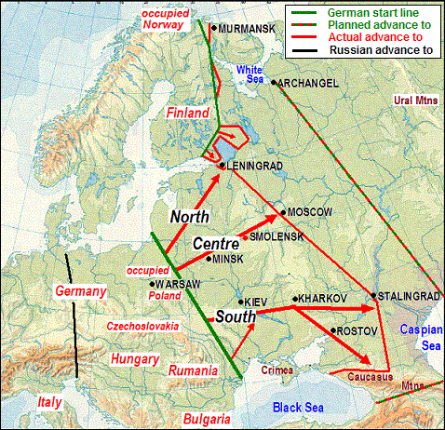

Slide 12
Battle of Stalingrad – Sept 1, 1942-February 1943
SIZE OF THE CITY: 30 KM LONG, ALONG THE Volga R.
SYMBOLIC IMPORTANCE: Hitler had lost and failed to cause the collapse of the Soviet Union
HITLER’S MISTAKE: Germany army is completely surrounded; Hitler’s troops were not dressed for the cold winter – he refused to face the reality of the situation (i.e. immense landscape, size of the front he was opening up, effects of Stalin’s “scorched earth policy”)

Slide 13
Are We the Baddies?
http://www.youtube.com/watch?v=hn1VxaMEjRU

Slide 14
Continued….
GERMAN LOSSES: 24 generals, 91,000 soldiers, and Field Marshall von Paulus surrendered – 300,000 dead; of the 100,000 prisoners, only 6,000 would come home to Germany
Significance of the Battle of Stalingrad:
1. For the 1st time in Hitler’s war, a German army in Europe had been beaten
2. Hitler failed to capture the oil rich region of the Caucasus
Hitler was fighting a 2 front war due to failure to take Moscow.

Slide 15
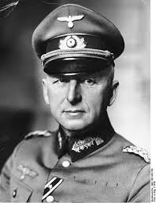
General Von Paulus
Paulus’s anger towards Hitler would remain with him for the rest of his life. He became involved in anti-Nazi propaganda.

Slide 16
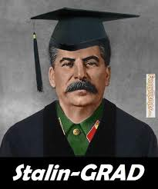
Congratulations: You are a Stalin-Grad

Slide 17
Battle of Stalingrad – History Channel
http://www.youtube.com/watch?v=akBS2TkZZNg

