Slide 1
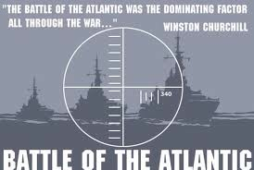
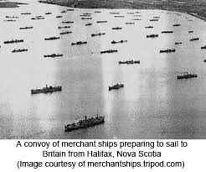
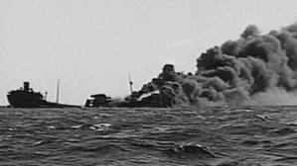
BATTLE OF THE ATLANTIC

Slide 2
U571 – Enigma Code Machine
https://www.youtube.com/watch?v=2imOf6-H3tI
(Trailer)
https://www.youtube.com/watch?v=eLyhRYJXf1U Sinking the Destroyer
(Video to show what would it be like to be in the Navy)
Highly Inaccurate: it was actually Britain (members on HMS Bulldog) who captured the Enigma machine from U-110 in the North Atlantic in May 1941.

Slide 3
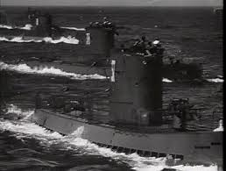
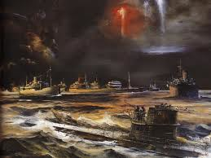
Battle of the Atlantic
Definition: The ongoing struggle of the allies to keep open her shipping lanes to Britain.
Most allied ships were sunk by U-Boats hunting in groups called “Wolf Packs”

Slide 4
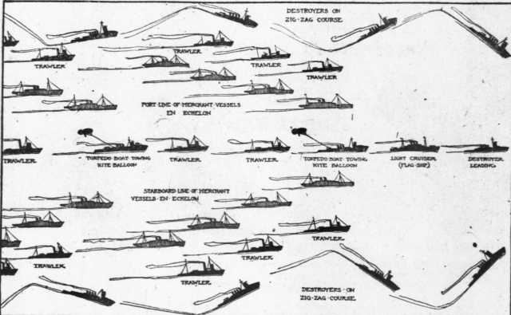
Convoy system

Slide 5
Operation Drumbeat (January – June 1942)
After the attack on Pearl Harbour on Dec 7, 1941, Germany declared war on the USA. Admiral Donitz (Germany) increased attacks and moved closer to American waters
The US, not used to naval war, did not immediately employ a black-out or an increased convoy system
The first U-boats reached US waters on January 13, 1942. By the time they withdrew on February 6, they had sunk 156,939 tonnes of shipping without loss.
This both increased convoy systems for the US and focused the attention of the German navy on the Atlantic instead of the Mediterranean

Slide 6
What changed to ‘turn the tide’ against the U-Boats?
1. Long range aircraft cooperating with naval support groups using radar.
2. Allies were punching through the soft underbelly of Europe.
3. Indiscriminate bombing of German Cities
4. Raids on French Ports – U-Boats were deployed to these locations
5. American involvement in the war
6. Enigma code allowed for British navy to know the location of German “wolf packs”

Slide 7
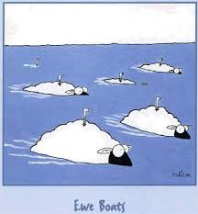
Significance
Supply lines were able to remain open; despite attempts by Doenitz and the Germans the “umbilical cord” between North America and Britain was not cut.
Supplies were crucial for the allies in both the East and in order to open a second front in the West.

