Slide 1
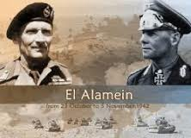
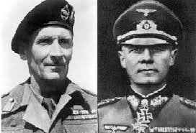
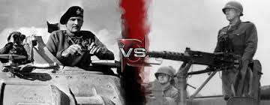
North Africa
Rommel Vs Montgomery

Slide 2
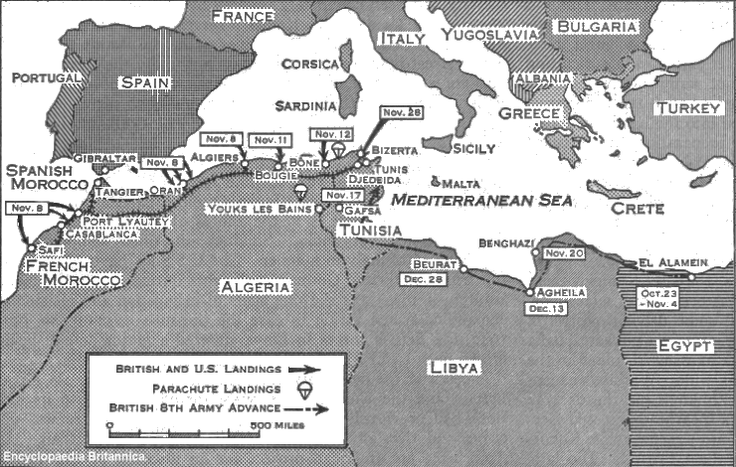

Slide 3
North Africa
Both the Axis and Allied powers knew that North Africa would be important for 3 main reasons:
(1) control of the Suez Canal
(2) oil fields
(3) Mediterranean sea
-the middle east was of great importance strategically to Britain’s empire

Slide 4
Important Developments:
Dec. 1940- General Wavell (BR.) counter-attacks against Italy in N.Africa
Feb.1942- Erwin Rommel (“desert fox”) takes command of German forces in N.Africa
Aug. 1941- Bernard Montgomery (“monty”) takes command of British forces in N.Africa
https://www.youtube.com/watch?v=4q66E-r9X8E Rommel Movie Trailer

Slide 5
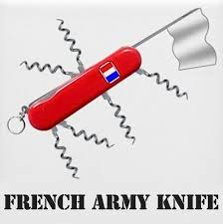
El Alamein Oct.1942
The small town of El Alamein is located 100 km west of the city Alexandria, Egypt.
The British nicknamed the “Desert Rats” defeated Rommel’s forces. As the German and Italian forces retreated over a 1,000 miles across N. Africa, the Free French Forces joined the war

Slide 6
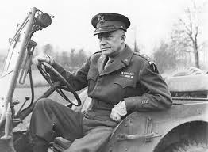
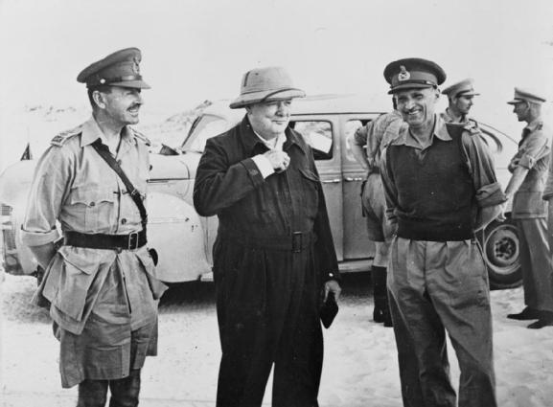
Continued
American forces under General Eisenhower landed in Morocco and advanced from the West (Operation Torch) NW Africa.
As the British advanced from the east, Rommel was trapped, but he escaped to Libya.
Winston Churchill with General Harold Alexander and Lieutenant General Bernard Montgomery, Commander-in-Chief 8th Army, during his second visit to the Western Desert, 23 August 1942. →

Slide 7
SIGNIFICANCE OF EL ALAMEIN /NORTH AMERICA:
1. One of the longest retreats in military history –Rommel 1,000 miles.
2. The war in North Africa was over.
3. Mistake on Hitler’s part not to take the Mediterranean War more seriously.
4. Troops diverted away from the Nazi invasion of Russia.
5. Shattering British victory against a heavily outnumbered enemy. Churchill needed a victory.
6. Kept Egypt and the Suez Canal out of German hands – kept the Middle East oil fields out of German control.

