Slide 1
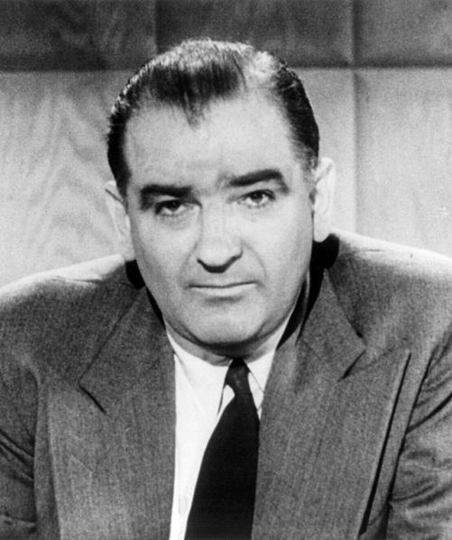
Kill a commie for mommy!
Notes:
Joseph Raymond "Joe" McCarthy (1908 –1957) was an American politician who served as a Republican U.S. Senator from the state of Wisconsin from 1947 until his death in 1957. Beginning in 1950, McCarthy became the most visible public face of a period in which Cold War tensions fueled fears of widespread Communist subversion. He was noted for making claims that there were large numbers of Communists and Soviet spies and sympathizers inside the United States federal government and elsewhere. Ultimately, his tactics and inability to substantiate his claims led him to be censured by the United States Senate.

Slide 2
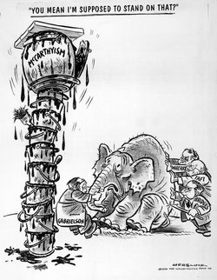
Notes:
The term McCarthyism, coined in 1950 in reference to McCarthy's practices, was soon applied to similar anti-communist activities. Today the term is used more generally in reference to demagogic, reckless, and unsubstantiated accusations, as well as public attacks on the character or patriotism of political opponents.
A demagogue or rabble-rouser is a political leader in a democracy who appeals to the emotions, fears, prejudices, and ignorance of the less-educated citizens in order to gain power and promote political motives
Herbert Block, who signed his work "Herblock", coined the term "McCarthyism" in this cartoon in the March 29, 1950, Washington Post.

Slide 3
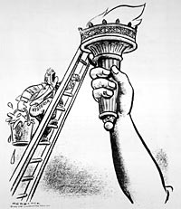

Slide 4
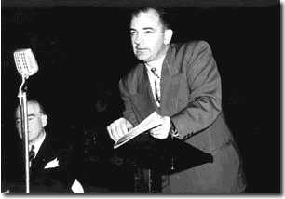
Notes:
After three largely undistinguished years in the Senate, McCarthy rose suddenly to national fame in February 1950 when he asserted in a speech that he had a list of "members of the Communist Party and members of a spy ring" who were employed in the State Department. McCarthy was never able to prove his sensational charge.
In succeeding years after his 1950 speech, McCarthy made additional accusations of Communist infiltration into the State Department, the administration of President Harry S. Truman and the United States Army. He also used various charges of communism, communist sympathies, disloyalty, or homosexuality to attack a number of politicians and other individuals inside and outside of government.

Slide 5
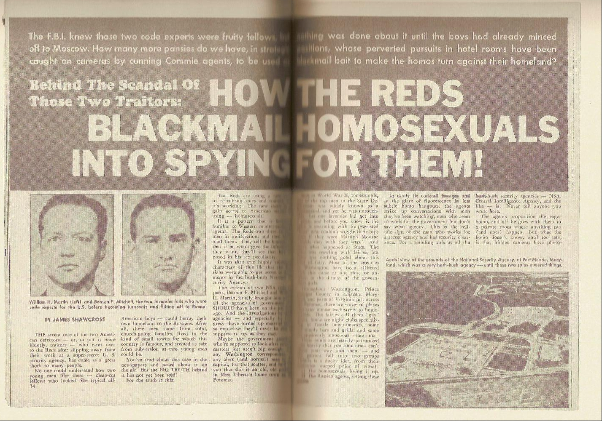
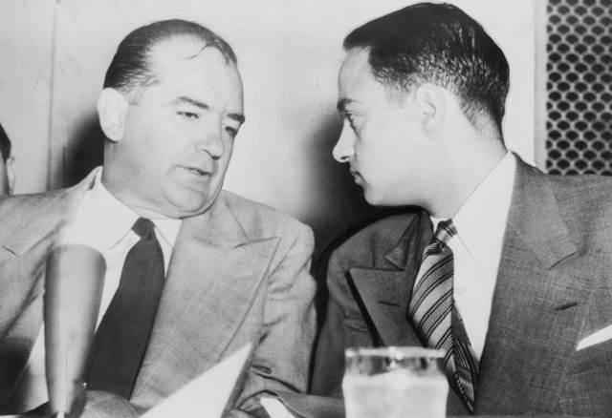
Notes:
Not as widely known as McCarthy's anti-Communist crusade were his various attempts to intimidate, and expel from government positions, persons whom he accused, or threatened to publicly accuse, of homosexuality. Former U.S. Senator Alan K. Simpson has written: "The so-called 'Red Scare' has been the main focus of most historians of that period of time. A lesser-known element…and one that harmed far more people was the witch-hunt McCarthy and others conducted against homosexuals.“ This anti-homosexual witch-hunt McCarthy and others waged alongside their "Red Scare" tactics has been referred to by some as the "Lavender Scare“.
Because the psychiatric community regarded homosexuality as a mental illness, gay men and lesbians were considered susceptible to blackmail, thus constituting a security risk. U.S. government officials assumed that communists would blackmail homosexual employees of the federal government who would provide them classified information rather than risk exposure.
McCarthy hired Roy Cohn — widely believed to be a closeted homosexual — as chief counsel of his Congressional subcommittee. Together, McCarthy and Cohn were responsible for the firing of scores of gay men from government employment, and strong-armed many opponents into silence using rumors of their homosexuality.

Slide 6
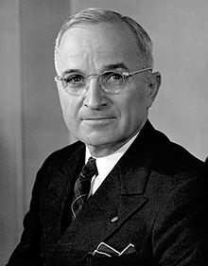
Notes:
McCarthy and President Truman clashed often during the years both held office. McCarthy characterized Truman and the Democratic Party as soft on, or even in league with, Communists, and spoke of the Democrats' "twenty years of treason." Truman, in turn, once referred to McCarthy as "the best asset the Kremlin has", calling McCarthy's actions an attempt to "sabotage the foreign policy of the United States" in a cold war and comparing it to shooting American soldiers in the back in a hot war.

Slide 7
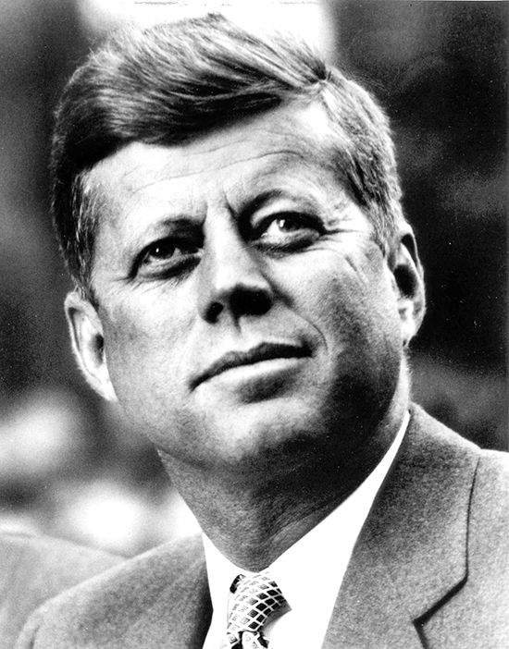
Notes:
One of the strongest bases of anti-Communist sentiment in the United States was the Catholic community, which constituted over 20% of the national vote. McCarthy identified himself as Catholic, and although the great majority of Catholics were Democrats, as his fame as a leading anti-Communist grew, he became popular in Catholic communities across the country, with strong support from many leading Catholics, diocesan newspapers, and Catholic journals.
McCarthy established a bond with the powerful Kennedy family, which had high visibility among Catholics. McCarthy became a close friend of Joseph P. Kennedy, Sr., himself a fervent anti-Communist, and was a frequent guest at the Kennedy compound in Hyannis Port. He dated two of Kennedy's daughters, Patricia and Eunice, and was godfather to Robert F. Kennedy's first child, Kathleen Kennedy.
Unlike many Democrats, John F. Kennedy, who served in the Senate with McCarthy from 1953 until the latter's death in 1957, never attacked McCarthy.

Slide 8
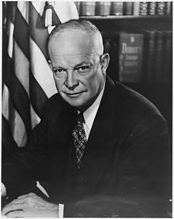
Notes:
After being elected president, Eisenhower made it clear to those close to him that he did not approve of McCarthy and he worked actively to diminish his power and influence. Still, he never directly confronted McCarthy or criticized him by name in any speech, thus perhaps prolonging McCarthy's power by giving the impression that even the President was afraid to criticize him directly.

Slide 9
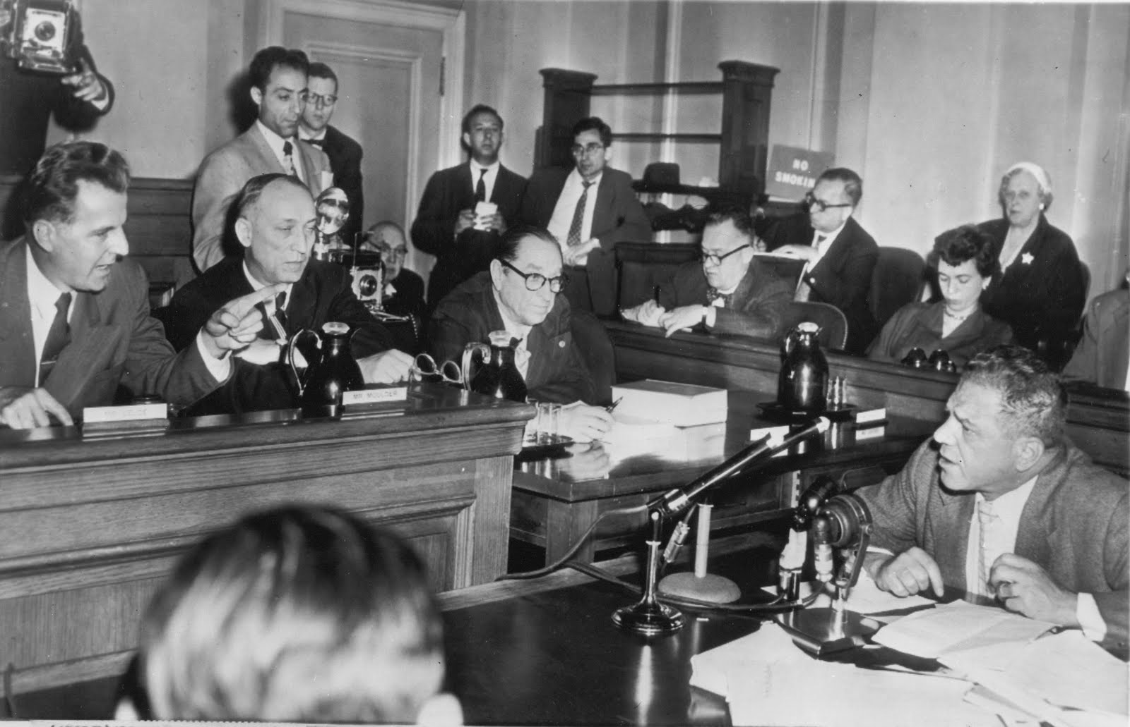
Notes:
The House Committee on Un-American Activities (HUAC) was an investigative committee of the United States House of Representatives. It was created in 1938 to investigate alleged disloyalty and subversive activities on the part of private citizens, public employees, and those organizations suspected of having Communist ties. The committee's anti-Communist investigations are often confused with those of Senator Joseph McCarthy. McCarthy, as a U.S. Senator, had no direct involvement with this House committee. McCarthy was the Chairman of the Government Operations Committee and its Permanent Subcommittee on Investigations of the U.S. Senate, not the House.
However, the HUAC relied heavily on the anti-communist fervor created through McCarthyism in order to continue its investigations of American citizens.

Slide 10
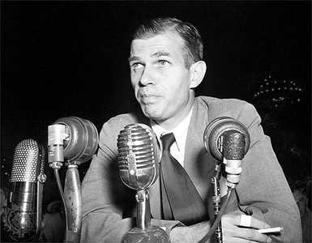
Notes:
Alger Hiss (1904 –1996) was an American lawyer, government official, author, and lecturer. He was involved in the establishment of the United Nations both as a U.S. State Department and U.N. official. Hiss was accused of being a Soviet spy in 1948 and convicted of perjury in connection with this charge in 1950.
On August 3, 1948, Whittaker Chambers, a former Communist Party member, testified under subpoena before the HUAC that Hiss had secretly been a Communist, though not a spy, while in federal service. Called before HUAC, Hiss categorically denied the charge.
In January 1950, he was found guilty on 2 counts of perjury and received two concurrent five-year sentences, of which he eventually served three and a half years. Hiss maintained his innocence until his death.

Slide 11
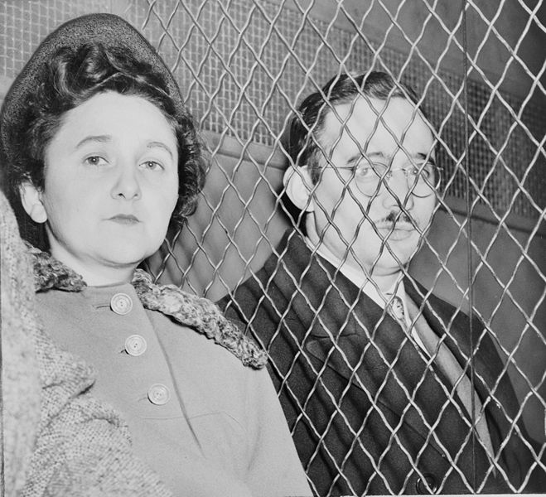
Notes:
Julius Rosenberg (1918 –, 1953) and Ethel Greenglass Rosenberg (1915 –1953) were United States citizens convicted of conspiracy to commit espionage during a time of war, and executed. Their charges were related to the passing of information about the atomic bomb to the Soviet Union.
In 1995, the U.S. government released a series of decoded Soviet cables, codenamed VENONA, which confirmed that Julius acted as a courier and recruiter for the Soviets but which were ambiguous about Ethel's involvement. The other atomic spies who were caught by the FBI offered confessions and were not executed, including Ethel's brother, David Greenglass, who supplied documents to Julius from Los Alamos and served 10 years of his 15-year sentence; Harry Gold, who identified Greenglass and served 15 years in Federal prison as the courier for Greenglass; and a German scientist, Klaus Fuchs.
Morton Sobell, who was tried with the Rosenbergs, served 17 years and 9 months of a 30-year sentence. In 2008, Sobell admitted he was a spy and confirmed Julius Rosenberg was "in a conspiracy that delivered to the Soviets classified military and industrial information and what the American government described as the secret to the atomic bomb.

Slide 12
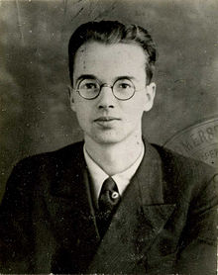
Notes:
Emil Julius Klaus Fuchs (1911 –1988) was a German theoretical physicist and atomic spy who in 1950 was convicted of supplying information from the American, British and Canadian Manhattan Project to the Soviet Union during and shortly after the Second World War. While at the Los Alamos National Laboratory, Fuchs was responsible for many significant theoretical calculations relating to the first nuclear weapons and later the early models of the hydrogen bomb.
In January 1950, Fuchs confessed that he was a spy. He was sentenced to fourteen years' imprisonment and stripped of his British citizenship. He was released in 1959, after serving nine years and emigrated to the German Democratic Republic (East Germany).

Slide 13
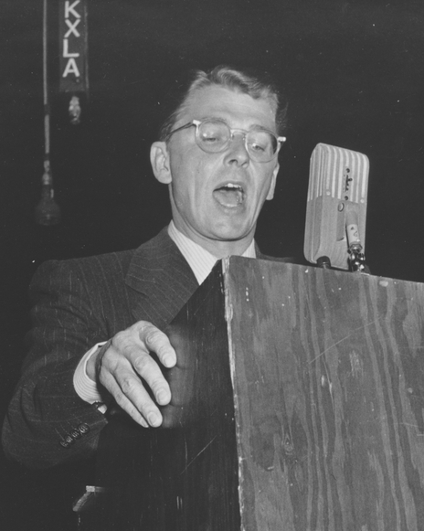
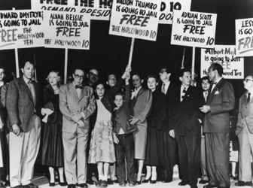
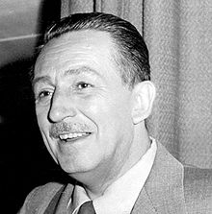
Notes:
In 1947, the committee held nine days of hearings into alleged communist propaganda and influence in the Hollywood motion picture industry. After conviction on contempt of Congress charges for refusal to answer some questions posed by committee members, the "Hollywood Ten" were blacklisted by the industry. Eventually, more than 300 artists—including directors, radio commentators, actors and particularly screenwriters—were boycotted by the studios. Some, like Charlie Chaplin, Orson Welles, Paul Robeson and Yip Harburg, left the U.S or went underground to find work. Others wrote under pseudonyms or the names of colleagues. Only about ten percent succeeded in rebuilding careers within the entertainment industry.
In 1941, producer Walt Disney took out an ad in Variety, the industry trade magazine, declaring his conviction that "Communist agitation" was behind a cartoonists and animators' strike.
During the late 1940s, Reagan and his wife, fervent anti-communists, provided the FBI with names of actors within the motion picture industry whom they believed to be communist sympathizers, Reagan testified before the House Un-American Activities Committee on the subject as well.

