Slide 1
The 8 Stages of Genocide & The Holocaust

Slide 2
THE 8 STAGES OF GENOCIDE*
Understanding the genocidal process is one of the
most important steps in preventing future genocides.
Stage 1: Classification
Stage 2: Symbolization
Stage 3: Dehumanization
Stage 4: Organization
Stage 5: Polarization
Stage 6: Preparation
Stage 7: Extermination
Stage 8: Denial
The first six stages are Early Warnings.
*The 8 Stages of Genocide were first outlined by Dr. Greg Stanton, Department of State: 1996.
Unit IV – The Rise of Totalitarianism & the Causes of World War II – The Holocaust

Slide 3
Racism + Social Darwinism
THE 8 STAGES OF GENOCIDE
In its simplest form, Social Darwinism is “survival of the fittest” applied to human sociology and politics.
In the late19th century, racism combined with the concept of Social Darwinism created ideas similar to Hitler’s.
Unit IV – The Rise of Totalitarianism & the Causes of World War II – The Holocaust

Slide 4
Racial Superiority
THE 8 STAGES OF GENOCIDE
In Mein Kampf (1925), Hitler described his ideas of a racial hierarchy with:
Aryans (the culture-producing race) at the top
Jews, Africans, and Gypsies (the culture-destroying races) at the bottom.
Inferior Peoples vs. Aryan Volk
In his speeches he played on fears that Germans would one day be outnumbered by inferior peoples and idealized a time when the Aryan "Volk" lived in harmony.
Unit IV – The Rise of Totalitarianism & the Causes of World War II – The Holocaust

Slide 5
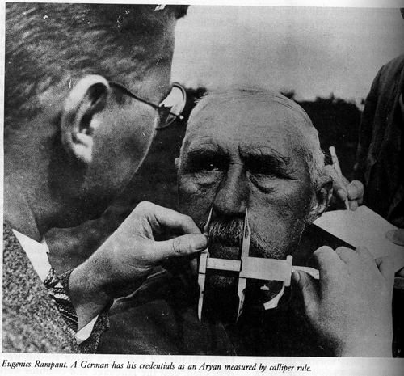
Stage 1: Classification
THE 8 STAGES OF GENOCIDE - CLASSIFICATION
“Us versus them”
Distinguish by nationality, ethnicity, race, or religion. All societies have classifications… groups with identifying features.
Classification is a primary method of dividing society and creating a power struggle between groups.
Physical Measurements
The Nazi Bureau for Enlightenment on Population Policy and Racial Welfare recommended the classification of Aryans and non-Aryans on the basis of measurements of the skull and other physical features.
Unit IV – The Rise of Totalitarianism & the Causes of World War II – The Holocaust

Slide 6
The Goal of Classification: Remove the so-called Inferior Types
THE 8 STAGES OF GENOCIDE - CLASSIFICATION
The Racial Hygiene Movement
The Racial Hygiene Movement (RHM), which began in Germany in 1905, had few supporters until the Nazis came to power.
“Only through [the Führer] did our dream of … applying racial hygiene to society become a reality.” -- Ernst Rüdin - Nazi psychiatrist
Hitler's goal was to remove what he thought were the inferior types from Germany, making more LEBENSRAUM (living room) for the so-called superior Aryans.
The Jews were the special object of his hatred.
Unit IV – The Rise of Totalitarianism & the Causes of World War II – The Holocaust

Slide 7
Euthanasia
THE 8 STAGES OF GENOCIDE - CLASSIFICATION
The RHM advocated the removal of those who would not improve the German race and had no use in society – those who Hitler called the "useless eaters."
This meant killing the mentally ill, the terminally ill, and the physically and mentally handicapped. They euphemistically called this "euthanasia."
Eugenics
Sterilization
It also meant eugenics – the science of improving the race through selective breeding. The Nazis required the sterilization of those who carried hereditary defects, such as types of blindness and deafness and certain diseases which were thought to have a genetic basis, such as Huntington's Chorea and epilepsy.
To further purify the race, women of mixed blood were to be sterilized.
Those with ideal Aryan characteristics were encouraged to have many children to contribute to the “Master Race.”
Unit IV – The Rise of Totalitarianism & the Causes of World War II – The Holocaust

Slide 8
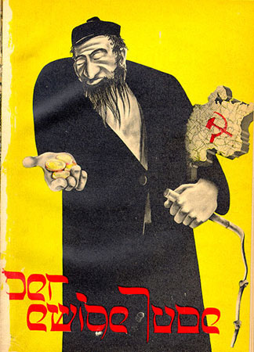
The War Against the Jews
THE 8 STAGES OF GENOCIDE - CLASSIFICATION
When the Nazis began to wage war against the Jews, they used rhetoric and propaganda.
The Wandering Jew
On 8 November 1937, a propaganda exhibit entitled Der Ewige Jude (The Wandering Jew) opened. It portrayed Jews as communists, swindlers and demons.
Over 150,000 people attended the exhibit in just three days.
From an anti-Semitic children's book. The sign reads "Jews are not wanted here"
Unit IV – The Rise of Totalitarianism & the Causes of World War II – The Holocaust

Slide 9
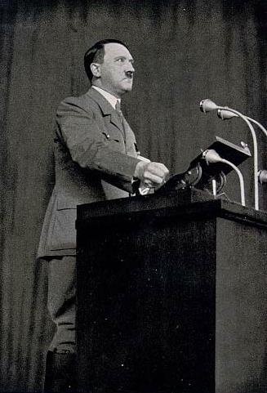
Communists and Thieves
THE 8 STAGES OF GENOCIDE - CLASSIFICATION
Jews were frequently associated with communists and thieves. The Wandering Jew later became a notorious hate film, and associated the Jews with rats and other vermin.
For those with ears to hear, Hitler promised the annihilation of the Jewish people in a speech to the Reichstag .
The headlines say "Jews are our misfortune" and "How the Jew cheats." Germany, 1936.
"...if the international Jewish financiers in and outside Europe should succeed in plunging the nations once more into a world war, then the result will not be the Bolshevizing of the earth, and thus the victory of Jewry, but the annihilation of the Jewish race in Europe!" -- Adolf Hitler, January 30, 1939
Unit IV – The Rise of Totalitarianism & the Causes of World War II – The Holocaust

Slide 10
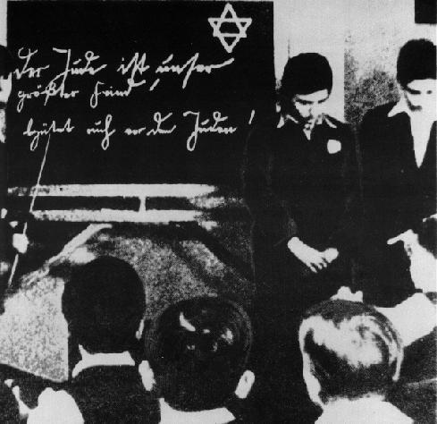
Harassment
THE 8 STAGES OF GENOCIDE - CLASSIFICATION
Harassment followed the limitations on the civil rights of Jewish citizens.
Jewish children humiliated in the classroom.
Unit IV – The Rise of Totalitarianism & the Causes of World War II – The Holocaust

Slide 11
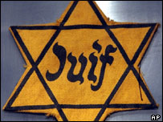
Stage 2: Symbolization
THE 8 STAGES OF GENOCIDE - SYMBOLIZATION
Names: “Jew”, “German”, “Hutu”, “Tutsi”.
Languages.
Types of dress.
Group uniforms: Nazi Swastika armbands
Colors and religious symbols:
Yellow stars for Jews
Blue checked scarf Eastern Zone in Cambodia
Unit IV – The Rise of Totalitarianism & the Causes of World War II – The Holocaust

Slide 12
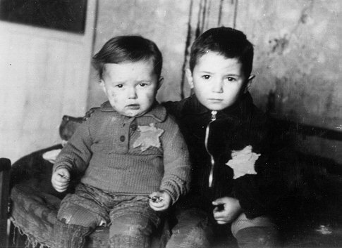
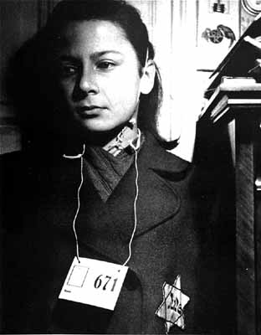
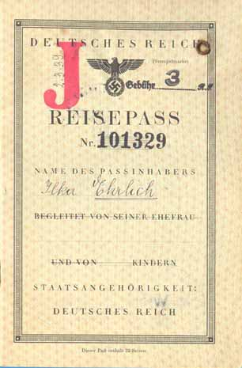
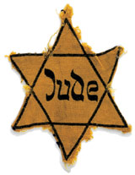
Symbolization in Nazi Germany
THE 8 STAGES OF GENOCIDE - SYMBOLIZATION
Jewish Passport: “Reisepäss”
Required to be carried by all Jews by 1938. Preceded the yellow star.
Nazis required the yellow Star of David emblem to be worn by nearly all Jews in Nazi-occupied Europe by 1941.
Unit IV – The Rise of Totalitarianism & the Causes of World War II – The Holocaust

Slide 13
The Nuremberg Race Laws
THE 8 STAGES OF GENOCIDE - SYMBOLIZATION
The Nuremberg Race Laws of 1935:
Deprived Jews of rights of citizenship
Prohibited marriage or sexual relations with Aryans
Prohibited employment of Aryans as household help
"The Law for the Protection of German Blood and German Honor" (prohibiting German- Jewish intermarriage)
"The Reich Citizenship Law" (designating Jews as subjects).
"The Law for the Protection of the Genetic Health of the German People" (requiring potential marriage partners to submit to a medical examination).
If they were disease free, they would be issued a "Certificate of Fitness to Marry."
The certificate was required in order to get a marriage license.
Unit IV – The Rise of Totalitarianism & the Causes of World War II – The Holocaust

Slide 14
Anti-Jewish Laws
THE 8 STAGES OF GENOCIDE - SYMBOLIZATION
Jews were expelled from government jobs
Jews were prohibited from becoming lawyers
Jewish children were prohibited from attending school & Jewish college students were expelled
Jews could not hire non-Jews
Jews were fired from jobs in department stores and other types of businesses
Jews could not marry non-Jews
Jewish doctors could only treat Jewish patients
Jewish businesses were confiscated
Food was rationed, curfews imposed & Jews were forced to live in certain areas
Jews were forced to wear the yellow star of David whenever they were in the street
Jewish houses had to be marked with a Star of David
Jewish people had to have Jewish names so they could be easily identified
Jews could not own pets
Jews could not have their hair cut by an Aryan
Jews could not own electrical appliances
Jews were not allowed to visit heated public shelters
Unit IV – The Rise of Totalitarianism & the Causes of World War II – The Holocaust

Slide 15
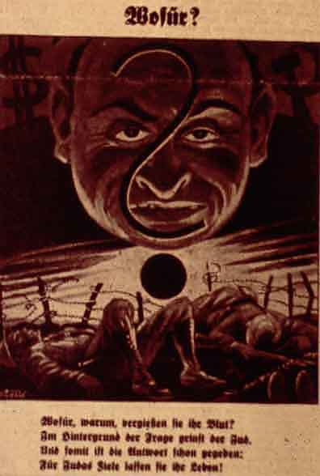
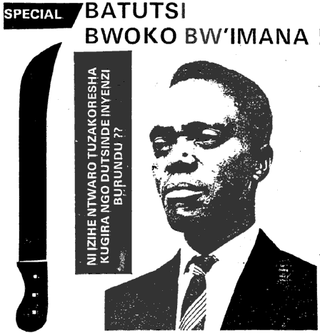
Stage 3: Dehumanization
THE 8 STAGES OF GENOCIDE -DEHUMANIZATION
One group denies the humanity of another group, and makes the victim group seem subhuman.
Dehumanization overcomes the normal human revulsion against murder.
Der Stürmer Nazi Newspaper:
“The Blood Flows; The Jew Grins”
Kangura Newspaper, Rwanda: “The Solution for Tutsi Cockroaches”
.
Unit IV – The Rise of Totalitarianism & the Causes of World War II – The Holocaust

Slide 16
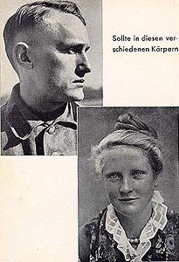
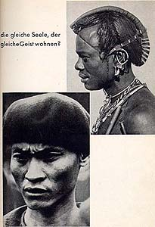
THE 8 STAGES OF GENOCIDE -DEHUMANIZATION
From a Nazi SS Propaganda Pamphlet:
Caption: Does the same soul dwell in these bodies?
Unit IV – The Rise of Totalitarianism & the Causes of World War II – The Holocaust

Slide 17
SS Tactics: Dehumanization
THE 8 STAGES OF GENOCIDE -DEHUMANIZATION
Hate propaganda in speeches, print, & on hate radios vilify the victim group.
Members of the victim group are described as animals, vermin, and diseases. Hate radio, Radio Télévision Libre des Mille Collines, during the Rwandan genocide in 1994, broadcast anti-Tutsi messages like “kill the cockroaches” and “If this disease is not treated immediately, it will destroy all the Hutu.”
Dehumanization invokes superiority of one group & inferiority of the “other.”
Dehumanization justifies murder by calling it “ethnic cleansing,” or “purification.” Such euphemisms attempt to justify the horror of mass murder.
The SS guards who murdered the Jews were brainwashed with Anti-Semitic propaganda.
The Jews were transported in cattle cars in terrible conditions.
Naked, dirty and half starved people look like animals, which helped to reinforce the Nazi propaganda.
The SS used to train their new guards by encouraging them to set fire to a pit full of live victims – usually children.
Unit IV – The Rise of Totalitarianism & the Causes of World War II – The Holocaust

Slide 18
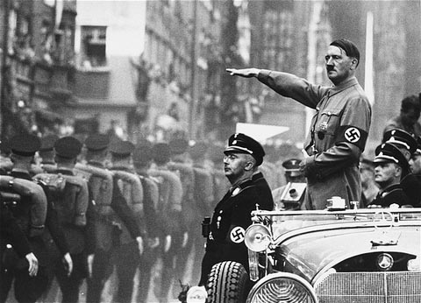
Stage 4: Organization
THE 8 STAGES OF GENOCIDE - ORGANIZATION
Genocide is a group crime, so must be organized.
The state usually organizes, arms and financially supports the groups that conduct the genocidal massacres.
Plans are made by elites for a “final solution” of genocidal killings.
Unit IV – The Rise of Totalitarianism & the Causes of World War II – The Holocaust

Slide 19
“Rise in Bloody Vengeance”
THE 8 STAGES OF GENOCIDE - ORGANIZATION
The German propaganda minister, Joseph Goebbels, incited Germans to "rise in bloody vengeance against the Jews.”
Mob violence broke out as the German police stood by and watched.
Storm troopers and members of the SS beat and murdered Jews along with the mobs.
Nearly 1000 synagogues were burned and thousands of Jews rounded up.
Unit IV – The Rise of Totalitarianism & the Causes of World War II – The Holocaust

Slide 20
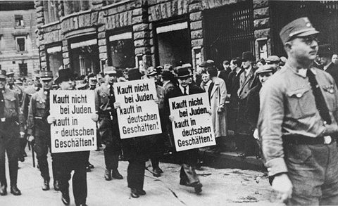
Stage 5: Polarization
THE 8 STAGES OF GENOCIDE - POLARIZATION
Extremists drive groups apart.
Hate groups broadcast and print polarizing propaganda.
Laws are passed that forbid intermarriage or social interaction.
Political moderates are silenced, threatened and intimidated, & killed.
Public demonstrations were organized against Jewish merchants.
Moderate German dissenters were the first to be arrested and sent to concentration camps.
Attacks are staged and blamed on targeted groups.
In Germany, the Reichstag fire was blamed on Jewish Communists in 1933.
Cultural centers of targeted groups are attacked.
Unit IV – The Rise of Totalitarianism & the Causes of World War II – The Holocaust

Slide 21
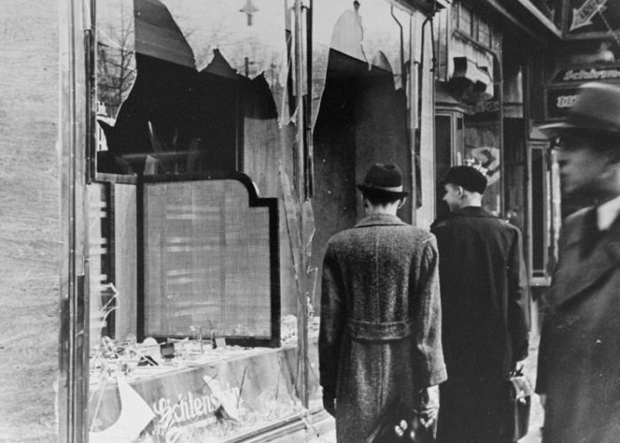
Kristallnacht
THE 8 STAGES OF GENOCIDE -DEHUMANIZATION
The evening of 9 November 1938, the "night of broken glass," many Jewish businesses, synagogues and homes were destroyed by mobs of people fired by propaganda and fueled by their own prejudice and ignorance.
Kristallnacht was a massive coordinated attack throughout the German Reich.
Unit IV – The Rise of Totalitarianism & the Causes of World War II – The Holocaust

Slide 22
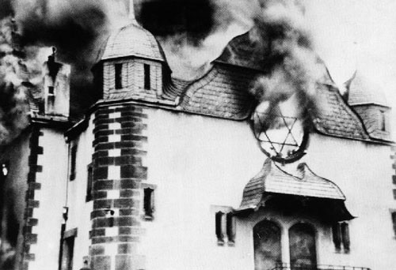
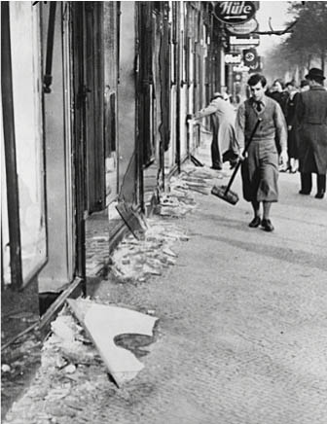
THE 8 STAGES OF GENOCIDE -DEHUMANIZATION
The burning of a synagogue during Kristallnacht
Unit IV – The Rise of Totalitarianism & the Causes of World War II – The Holocaust

Slide 23
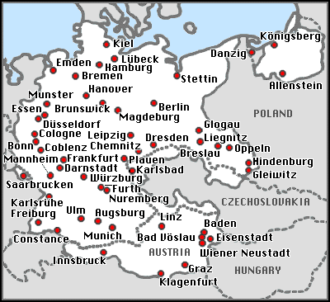
THE 8 STAGES OF GENOCIDE - ORGANIZATION
Synagogues burned on the night of Kristallnacht
Unit IV – The Rise of Totalitarianism & the Causes of World War II – The Holocaust

Slide 24
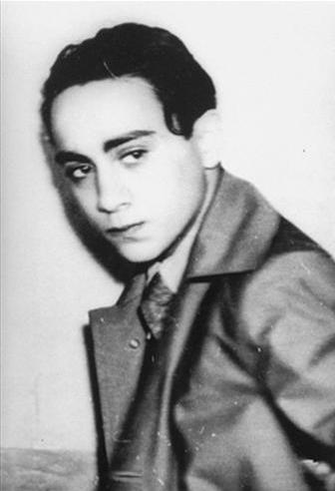
In Retaliation for Nazi Mistreatment
THE 8 STAGES OF GENOCIDE -DEHUMANIZATION
The attacks came after Herschel Grynszpan, a 17 year old Polish-Jewish refugee (born in Hanover, Germany) living in Paris, shot and killed a member of the German Embassy in retaliation for the poor treatment his father and his family suffered at the hands of the Nazis. His family, along with 12,000 other Jews, had been stripped of their possessions and transported in boxcars and dumped at the Polish border.
Unit IV – The Rise of Totalitarianism & the Causes of World War II – The Holocaust

Slide 25
Ghettos
THE 8 STAGES OF GENOCIDE - POLARIZATION
Jewish people were herded into ghettos (walled off parts of the city in which the people could be more easily controlled). Joseph Goebbels called the ghettos "death boxes"
Waiting for a drink of water in the Warsaw Ghetto, where water and food were in short supply.
Unit IV – The Rise of Totalitarianism & the Causes of World War II – The Holocaust

Slide 26
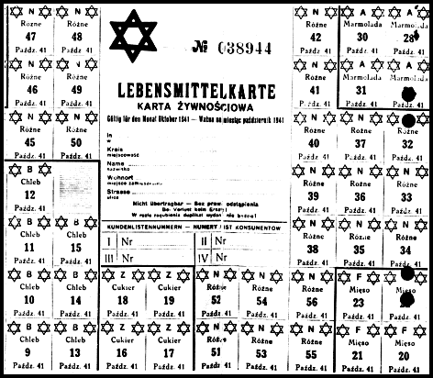
THE 8 STAGES OF GENOCIDE - POLARIZATION
This ration card from October 1941 entitled a resident to 300 calories a day.
Unit IV – The Rise of Totalitarianism & the Causes of World War II – The Holocaust

Slide 27
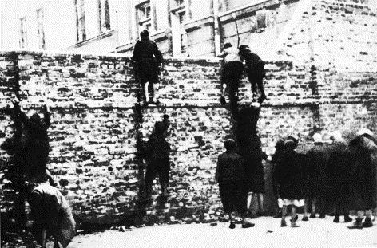
THE 8 STAGES OF GENOCIDE - POLARIZATION
Children climbing the walls to smuggle food into the Warsaw Ghetto
Unit IV – The Rise of Totalitarianism & the Causes of World War II – The Holocaust

Slide 28
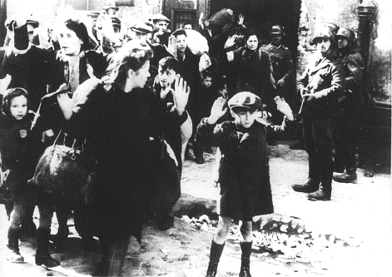
THE 8 STAGES OF GENOCIDE - POLARIZATION
The Warsaw Ghetto Uprising April - May 1943
Unit IV – The Rise of Totalitarianism & the Causes of World War II – The Holocaust

Slide 29
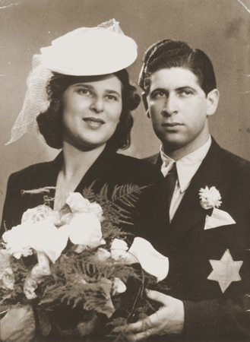
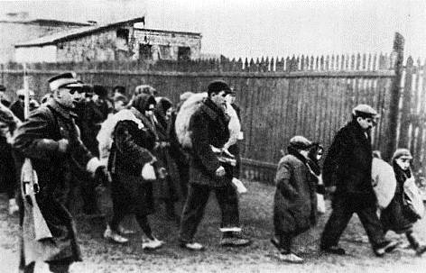
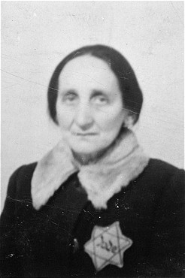
Stage 6: Preparation
THE 8 STAGES OF GENOCIDE - PREPARATION
Members of victim groups are forced to wear identifying symbols.
Death lists are made.
Victims are separated because of their ethnic or religious identity.
Unit IV – The Rise of Totalitarianism & the Causes of World War II – The Holocaust

Slide 30
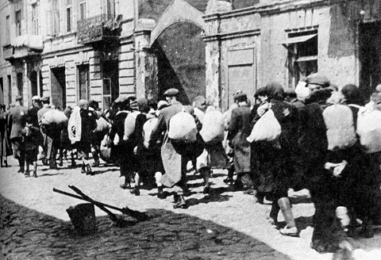
THE 8 STAGES OF GENOCIDE - PREPARATION
Segregation into ghettoes is imposed, victims are forced into concentration camps.
Victims are also deported to famine-struck regions for starvation.
Forced Resettlement into Ghettos – Poland 1939 - 1942
Unit IV – The Rise of Totalitarianism & the Causes of World War II – The Holocaust

Slide 31
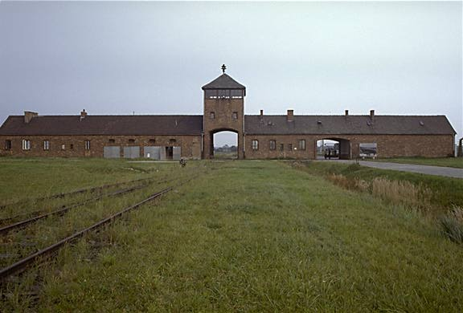
THE 8 STAGES OF GENOCIDE - PREPARATION
Weapons for killing are stock-piled.
Extermination camps are even built. This build- up of killing capacity is a major step towards actual genocide.
Unit IV – The Rise of Totalitarianism & the Causes of World War II – The Holocaust

Slide 32
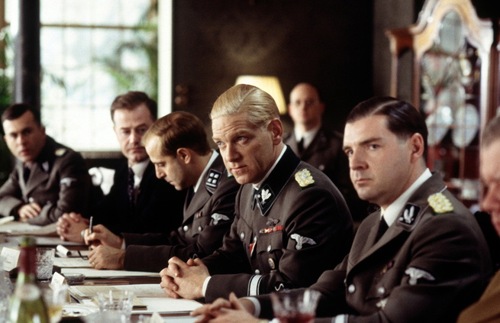
The Final Solution
THE 8 STAGES OF GENOCIDE - PREPARATION
In January 1942, senior Nazi officials held a top secret meeting to discuss the "final solution of the Jewish question," in the Berlin suberb, Wansee. Known as the Wansee Conference, this meeting did not begin the killing of the Jews, but in it, the Nazis’ articulated their plans clearly and determined on a systematic method to carry them out.
In a scene from the 2001 movie “Conspiracy”, senior Nazi officials discuss The Final Solution.
Unit IV – The Rise of Totalitarianism & the Causes of World War II – The Holocaust

Slide 33
Wannsee Conference
THE 8 STAGES OF GENOCIDE - PREPARATION
Women, children, the old & the sick were to be sent for ‘special treatment.’
The young and fit would go through a process called ‘destruction through work.’
Shooting was too inefficient as the bullets were needed for the war effort
How was the Final Solution going to be organized?
On arrival the Jews would go through a process called ‘selection.’
Jews were to be rounded up and put into transit camps called Ghettoes
The remaining Jews were to be shipped to ‘resettlement areas’ in the East.
The Jews living in these Ghettos were to be used as a cheap source of labor.
Conditions in the Ghettos were designed to be so bad that many die while the rest would be willing to leave these areas in the hope of better conditions
Unit IV – The Rise of Totalitarianism & the Causes of World War II – The Holocaust

Slide 34
Stage 7: Extermination (Genocide)
THE 8 STAGES OF GENOCIDE - EXTERMINATION
Extermination begins, and becomes the mass killing legally called "genocide." Most genocide is committed by governments.
Einsatzgrupen: Nazi Killing Squads
Unit IV – The Rise of Totalitarianism & the Causes of World War II – The Holocaust

Slide 35
Phase 1 = Shooting
THE 8 STAGES OF GENOCIDE - EXTERMINATION
Jews were rounded up and told they were to be relocated
They were taken to the woods and were shot one by one
Their bodies were buried in mass graves
Unit IV – The Rise of Totalitarianism & the Causes of World War II – The Holocaust

Slide 36
Phase 2 = Gas Vans
THE 8 STAGES OF GENOCIDE - EXTERMINATION
Again, Jews were rounded up and told they were to be relocated in vans
The vans were equipped so that the van’s exhaust was piped back into the van, thus asphyxiating them.
700,000 Jews killed in Vans
Unit IV – The Rise of Totalitarianism & the Causes of World War II – The Holocaust

Slide 37
Problems with Phases 1 & 2
THE 8 STAGES OF GENOCIDE - EXTERMINATION
The Nazis encountered several problems with the executions & gas vans
First, they were both taking too much time
Second, resources such as gas and munitions were becoming scarce
Third, soldiers involved were beginning to have psychological problems with what they were doing.
Unit IV – The Rise of Totalitarianism & the Causes of World War II – The Holocaust

Slide 38
Phase 3 = The Camps
THE 8 STAGES OF GENOCIDE - EXTERMINATION
Nazi leaders decided to drastically speed up the Final Solution
There were two different types of camps:
CONCENTRATION CAMPS
EXTERMINATION CAMPS
Jews from all over occupied Europe were to be brought here.
Unit IV – The Rise of Totalitarianism & the Causes of World War II – The Holocaust

Slide 39
What tactics did the Nazis use to get the Jews to leave the Ghettos?
THE 8 STAGES OF GENOCIDE - EXTERMINATION
Deception
New arrivals at the Death camps were given postcards to send to their friends.
Starvation
The Jews were told that they were going to ‘resettlement areas’ in the East.
The Jews in the Warsaw Ghetto were only fed a 1000 calories a day .
In some Ghettos the Jews had to purchase their own train tickets.
Tactics
A Human being needs 2400 calories a day to maintain their weight
Terror
They were told to bring the tools of their trade and pots and pans.
The SS publicly shot people for smuggling food or for any act of resistance
Hungry people are easier to control
Unit IV – The Rise of Totalitarianism & the Causes of World War II – The Holocaust

Slide 40
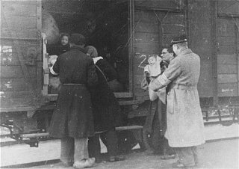
THE 8 STAGES OF GENOCIDE - EXTERMINATION
Jewish prisoners are loaded onto the train from Westerbork, a transit camp, on their way to a concentration camp
Unit IV – The Rise of Totalitarianism & the Causes of World War II – The Holocaust

Slide 41
Concentration Camps
THE 8 STAGES OF GENOCIDE - EXTERMINATION
In the next phase of the "final solution" Nazis separated out the young, the old, and the ill and sent them to their deaths. The gas chamber was used in the extermination camps such as Auschwitz. Those who could work obtained only a temporary reprieve.
Inmates at Sachenhausen wearing identifying badges
Unit IV – The Rise of Totalitarianism & the Causes of World War II – The Holocaust

Slide 42
Tactics: What happened to new arrivals?
THE 8 STAGES OF GENOCIDE - EXTERMINATION
All new arrivals went through a process known as ‘selection.’
At Auschwitz the trains pulled into a mock up of a normal station.
Mothers, children, the old & sick were sent straight to the ‘showers’ which were really the gas chambers.
The Jews were helped off the cattle trucks by Jews who were specially selected to help the Nazis
Deception & Selection
The able bodied were sent to work camp were they were killed through a process known as ‘destruction through work.’
At some death camps the Nazis would play records of classical music to help calm down the new arrivals.
At Auschwitz the new arrivals were calmed down by a Jewish orchestra playing classical music.
Unit IV – The Rise of Totalitarianism & the Causes of World War II – The Holocaust

Slide 43
Entrance to Auschwitz
THE 8 STAGES OF GENOCIDE - EXTERMINATION
Notice how it has been built to resemble a railway station
Unit IV – The Rise of Totalitarianism & the Causes of World War II – The Holocaust

Slide 44
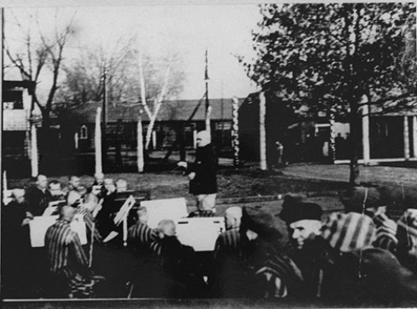
Auschwitz Orchestra
THE 8 STAGES OF GENOCIDE - EXTERMINATION
Unit IV – The Rise of Totalitarianism & the Causes of World War II – The Holocaust

Slide 45
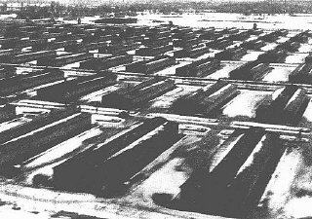
THE 8 STAGES OF GENOCIDE - EXTERMINATION
Barracks at Auschwitz
Unit IV – The Rise of Totalitarianism & the Causes of World War II – The Holocaust

Slide 46
Extermination (Genocide)
THE 8 STAGES OF GENOCIDE - EXTERMINATION
The killing is “extermination” to the killers because they do not believe the victims are fully human. They are “cleansing” the society of impurities, disease, animals, vermin, “cockroaches,” or enemies.
Roma (Gypsies) in a Nazi death camp
Unit IV – The Rise of Totalitarianism & the Causes of World War II – The Holocaust

Slide 47
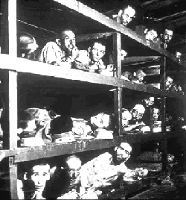
THE 8 STAGES OF GENOCIDE - EXTERMINATION
Prisoners at Dachau
Unit IV – The Rise of Totalitarianism & the Causes of World War II – The Holocaust

Slide 48
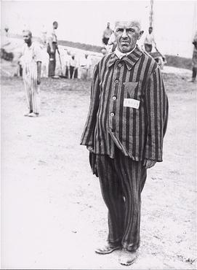
Life in a Concentration Camp
THE 8 STAGES OF GENOCIDE - EXTERMINATION
A prisoner in Dachau is forced to stand without moving for endless hours as a punishment. He is wearing a triangle patch identification on his chest.
A chart of prisoner triangle identification markings used in Nazi concentration camps which allowed the guards to easily see which type of prisoner any individual was.
Unit IV – The Rise of Totalitarianism & the Causes of World War II – The Holocaust

Slide 49
Gas Chambers
THE 8 STAGES OF GENOCIDE - EXTERMINATION
GAS USED TO KILL VERMIN. IT WAS INEXPENSIVE COMPARED TO GAS. DROPPED FROM CEILINGS
The Nazis would force large groups of prisoners into small cement rooms and drop canisters of Zyklon B, or prussic acid, in its crystal form through small holes in the roof.
These gas chambers were sometimes disguised as showers or bathing houses.
Unit IV – The Rise of Totalitarianism & the Causes of World War II – The Holocaust

Slide 50
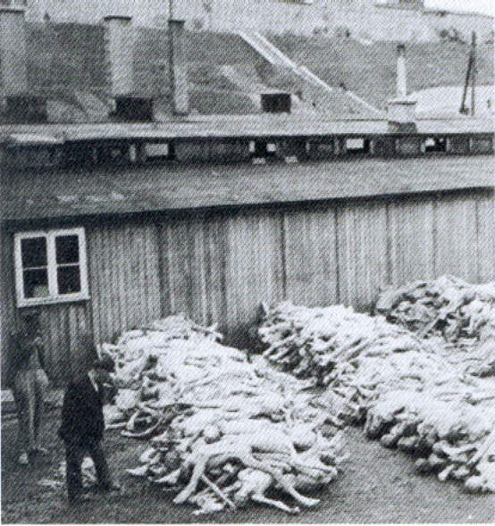
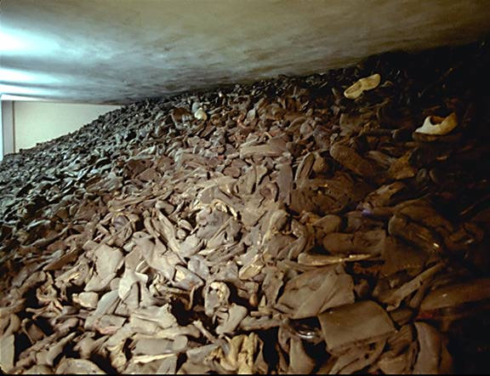
Dead bodies waiting for cremation
THE 8 STAGES OF GENOCIDE - EXTERMINATION
Shoes waiting for processing by the sonderkommando
Taken inside a huge glass case in the Auschwitz Museum. This represents one day's collection at the peak of the gassings, about twenty five thousand pairs.
Unit IV – The Rise of Totalitarianism & the Causes of World War II – The Holocaust

Slide 51
Destruction Through Work
THE 8 STAGES OF GENOCIDE - EXTERMINATION
This photo was taken by the Nazis to show just how you could quite literally work the fat off the prisoners by feeding them 200 calories a day
Same group 6 weeks later
Unit IV – The Rise of Totalitarianism & the Causes of World War II – The Holocaust

Slide 52
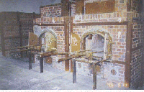
Processing the bodies
THE 8 STAGES OF GENOCIDE - EXTERMINATION
Specially selected Jews known as the sonderkommando were used to to remove the gold fillings and hair of people before they are cremated.
The Sonderkommando Jews were also forced to feed the dead bodies into the crematorium.
The Crematorium at Dachau
Unit IV – The Rise of Totalitarianism & the Causes of World War II – The Holocaust

Slide 53
Dr. Josef Mengele
THE 8 STAGES OF GENOCIDE - EXTERMINATION
Arrived in Auschwitz in May of 1943
SS Doctor who had power of life/death
performed medical experiments on Jewish children
“ANGEL OF DEATH”
Unit IV – The Rise of Totalitarianism & the Causes of World War II – The Holocaust

Slide 54
MEDICAL EXPERIMENTS
THE 8 STAGES OF GENOCIDE - EXTERMINATION
Sterilization of men and women
Endurance of pain to high and low temperatures and pressure
Experiments on twins to increase number of multiple births to Aryan women
Injections of phenol to kill patients
Dr. Mengele attempted to sew children together to make Siamese twins
Unit IV – The Rise of Totalitarianism & the Causes of World War II – The Holocaust

Slide 55
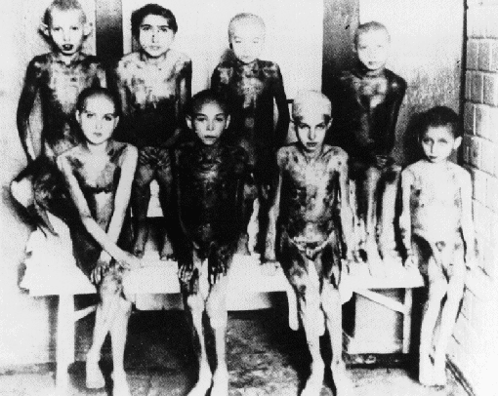
MEDICAL EXPERIMENTS
THE 8 STAGES OF GENOCIDE - EXTERMINATION
EXTRACTED HUMAN ORGANS
EXPERIMENTS ON CHILDREN IN AUSCHWITZ
Unit IV – The Rise of Totalitarianism & the Causes of World War II – The Holocaust

Slide 56
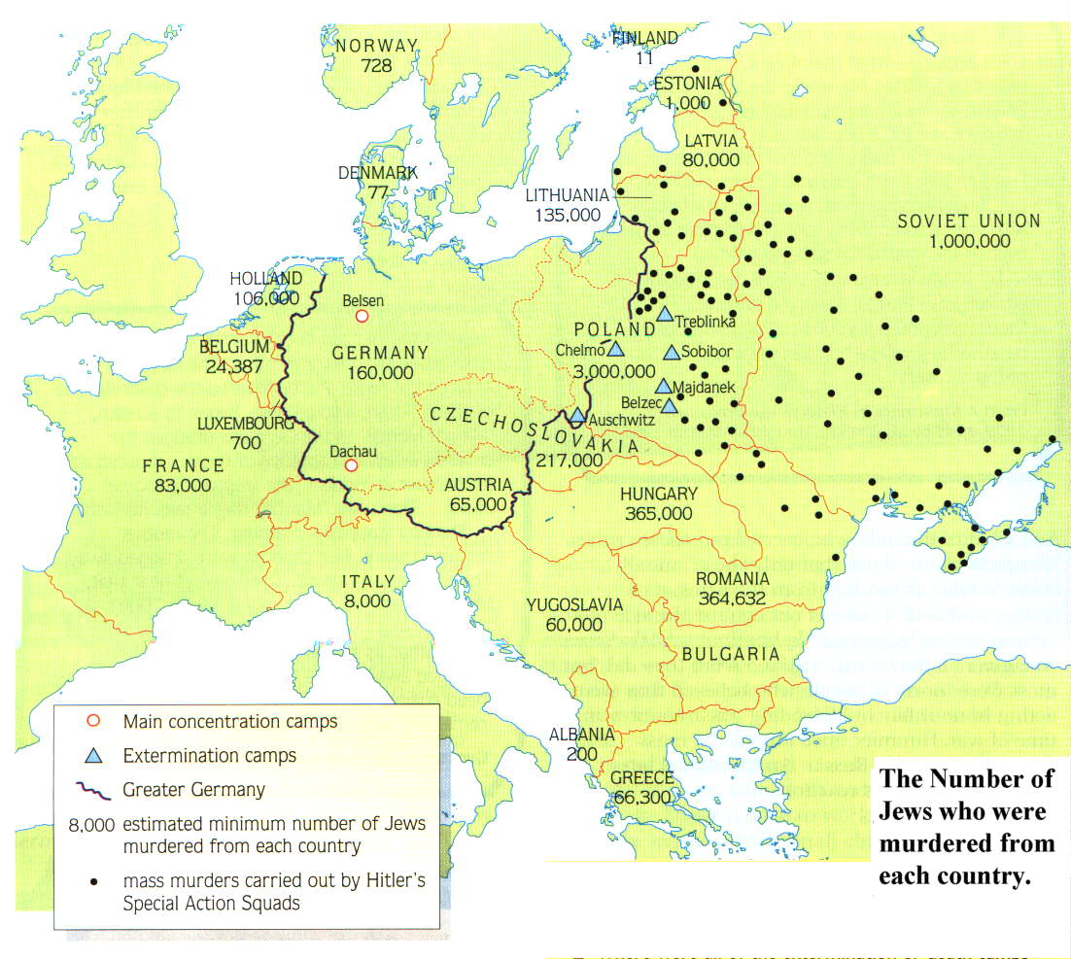
Where were the Death Camps built?
THE 8 STAGES OF GENOCIDE - EXTERMINATION
The work of the Einsatzgruppen
Why do you think that they located them here?
Unit IV – The Rise of Totalitarianism & the Causes of World War II – The Holocaust
Notes:
Remember that the black dots represent the work of the Einsatzgruppen

Slide 57
OPERATION REINHARD
THE 8 STAGES OF GENOCIDE - EXTERMINATION
Largest single massacre of Holocaust
March 1942-November 1943
named after Reinhard Heydrich
carried out at three camps, run by the SS
every Jew that arrived at one of the camps would be dead in 2 hours.
Total of 1,700,000 Jews killed
Unit IV – The Rise of Totalitarianism & the Causes of World War II – The Holocaust

Slide 58
Einsatzgruppen
THE 8 STAGES OF GENOCIDE - EXTERMINATION
Not all murdered Jews were killed in the camps. A mobile killing force called the Einsatzgrubben conducted many executions, particularly in the Ukraine and Baltic states.
Jews from Lubny (Ukraine) assembled just prior to execution
Unit IV – The Rise of Totalitarianism & the Causes of World War II – The Holocaust

Slide 59
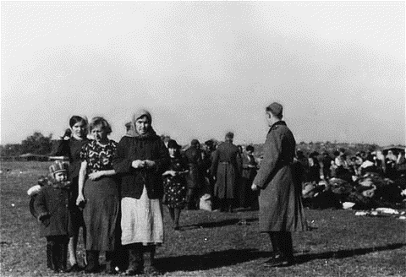
THE 8 STAGES OF GENOCIDE - EXTERMINATION
Jewish victims who have been asked to remove their outer garments prior to execution
Unit IV – The Rise of Totalitarianism & the Causes of World War II – The Holocaust

Slide 60
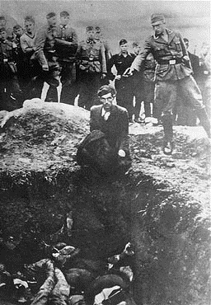
THE 8 STAGES OF GENOCIDE - EXTERMINATION
Einsatzgrubben executions in the Ukraine
Unit IV – The Rise of Totalitarianism & the Causes of World War II – The Holocaust

Slide 61
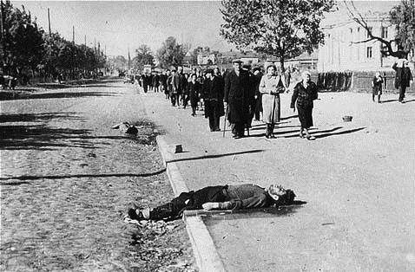
THE 8 STAGES OF GENOCIDE - EXTERMINATION
Jewish citizens of Kiev marching to Babi Yar
Unit IV – The Rise of Totalitarianism & the Causes of World War II – The Holocaust

Slide 62
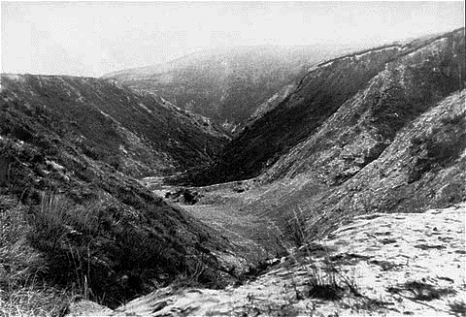
THE 8 STAGES OF GENOCIDE - EXTERMINATION
The ravine at Babi Yar, scene of mass executions in 1941. Ensatzgrubben killed 33,000 citizens of Kiev by gunning them down on the edge of the ravine.
Unit IV – The Rise of Totalitarianism & the Causes of World War II – The Holocaust

Slide 63
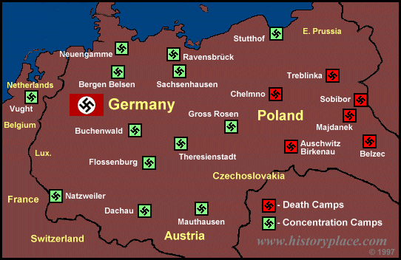
THE 8 STAGES OF GENOCIDE - EXTERMINATION
Unit IV – The Rise of Totalitarianism & the Causes of World War II – The Holocaust

Slide 64
RAVENSBRUCK
THE 8 STAGES OF GENOCIDE - EXTERMINATION
Camp for women only
run by German women who were criminals
prisoners worked on remodeling furs
50,000 killed
14,000 rescued by Swedish diplomat
Count Folke Bernadette negotiating for prisoners
Unit IV – The Rise of Totalitarianism & the Causes of World War II – The Holocaust

Slide 65
THERESIENSTADT
THE 8 STAGES OF GENOCIDE - EXTERMINATION
Most humane camp
well connected Jews and war veterans
Jews married to Aryans could pay to go to this camp
Red Cross inspected this camp, good rating
stop over on the way to Auschwitz
Jewish band playing for Red Cross inspection team
Unit IV – The Rise of Totalitarianism & the Causes of World War II – The Holocaust

Slide 66
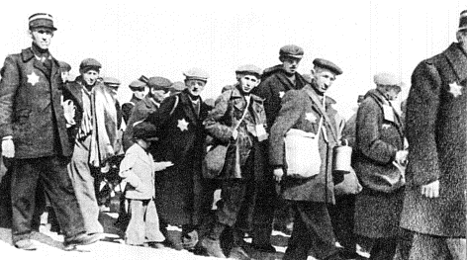
CHELMNO
THE 8 STAGES OF GENOCIDE - EXTERMINATION
Jews from the Lodz ghetto in Poland sent here
First death camp built = 1941
First to use Gas Vans on Jews
Unit IV – The Rise of Totalitarianism & the Causes of World War II – The Holocaust

Slide 67
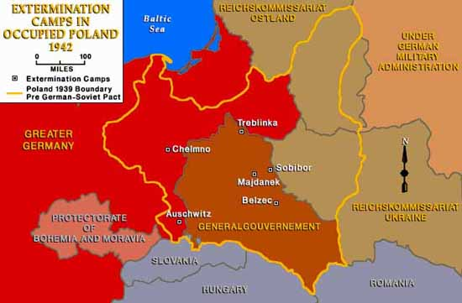
THE 8 STAGES OF GENOCIDE - EXTERMINATION
MAP OF CAMPS IN POLAND
Unit IV – The Rise of Totalitarianism & the Causes of World War II – The Holocaust

Slide 68
MAJDANEK
THE 8 STAGES OF GENOCIDE - EXTERMINATION
Established in 1941 as a POW camp
started its part in the Final Solution in 1942
Jews, Poles and Soviet POW’s sent here
had two gas chambers to exterminate
Unit IV – The Rise of Totalitarianism & the Causes of World War II – The Holocaust

Slide 69
AUSCHWITZ
THE 8 STAGES OF GENOCIDE - EXTERMINATION
Started operations in January 1940 (Poland)
Himmler chose Auschwitz as the place for the Final Solution
had 4 gas chambers/crematories by 1943
mass killings with Zyklon B gas
commanded by Rudolph Hoess
recorded 12,000 kills in one day
Unit IV – The Rise of Totalitarianism & the Causes of World War II – The Holocaust

Slide 70
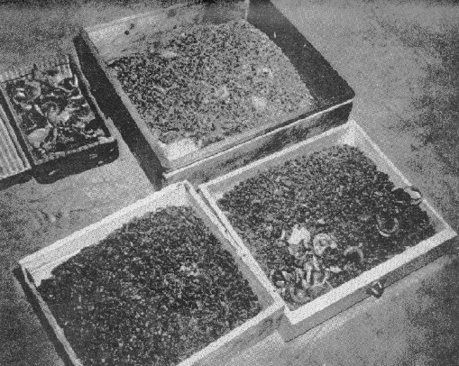
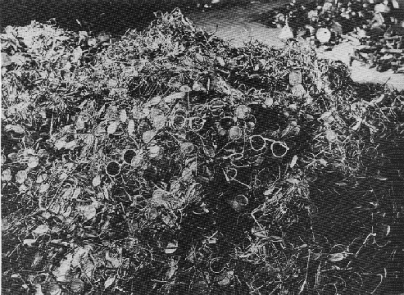
THE SS AT AUSCHWITZ
THE 8 STAGES OF GENOCIDE - EXTERMINATION
ORDERED TO TAKE ALL POSSESSIONS FROM JEWS
TEETH WITH GOLD
PILES OF GLASSES
Unit IV – The Rise of Totalitarianism & the Causes of World War II – The Holocaust

Slide 71
BELZEC
THE 8 STAGES OF GENOCIDE - EXTERMINATION
MARCH 1942
JEWS FROM LUBIN GHETTO- POLAND
OPERATIONS STOP DECEMBER 1942
CAMP WAS DISMANTLED AND PLOWED OVER AND PLANTED ON
Unit IV – The Rise of Totalitarianism & the Causes of World War II – The Holocaust

Slide 72
SOBIBOR
THE 8 STAGES OF GENOCIDE - EXTERMINATION
MAY 1942
3 GAS CHAMBERS
ESCAPE OF 300 JEWS AND SOVIET POW’S
ONLY 50 LIVE
GAS CHAMBERS SHUT DOWN AFTER ESCAPE
Unit IV – The Rise of Totalitarianism & the Causes of World War II – The Holocaust

Slide 73
TREBLINKA
THE 8 STAGES OF GENOCIDE - EXTERMINATION
JEWS FROM WARSAW GHETTO
10 GAS CHAMBERS
LOCATED EAST OF WARSAW
BODIES WERE BURNED IN OPEN PITS
AUGUST 1943
Unit IV – The Rise of Totalitarianism & the Causes of World War II – The Holocaust

Slide 74
STATISTICS BY COUNTRY
THE 8 STAGES OF GENOCIDE - EXTERMINATION
Jewish population before, Jewish population after Holocaust
Unit IV – The Rise of Totalitarianism & the Causes of World War II – The Holocaust

Slide 75
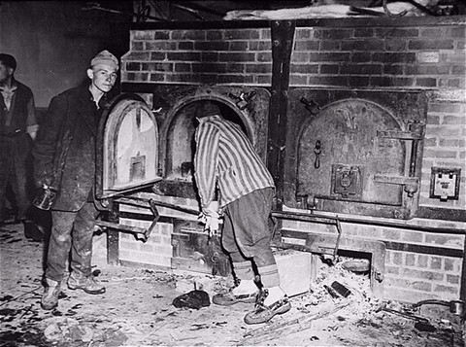
Liberation
THE 8 STAGES OF GENOCIDE - EXTERMINATION
In 1945 the camps were liberated. In the last days the Nazis were still unwilling to give up the plan to exterminate the Jews. They either executed Jews in the camps as they abandoned them, death-marched them into the interior of Germany, or cut off food and water, leaving them to die.
Survivors in Mauthausen open one of the crematoria ovens for American troops who are inspecting the camp.
Unit IV – The Rise of Totalitarianism & the Causes of World War II – The Holocaust

Slide 76
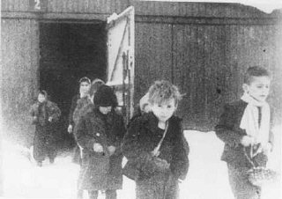
THE 8 STAGES OF GENOCIDE - EXTERMINATION
Children at Auschwitz. The lucky ones were liberated in 1945.
Unit IV – The Rise of Totalitarianism & the Causes of World War II – The Holocaust

Slide 77
THE 8 STAGES OF GENOCIDE - EXTERMINATION
Mass grave site at Bergen-Belsen. The British found many dead when they liberated the camp.
Unit IV – The Rise of Totalitarianism & the Causes of World War II – The Holocaust

Slide 78
Was the Final Solution successful?
THE 8 STAGES OF GENOCIDE - EXTERMINATION
The Nazis aimed to kill 11 million Jews at the Wannsee Conference in 1942
Today there are only 2000 Jews living in Poland.
The Nazis managed to kill 6 million Jews.
Men like Schindler helped Jews escape the Final Solution.
Not all Jews went quietly into the gas chambers.
In 1943, the Warsaw Ghetto, like many others revolted against the Nazis when the Jews realized what was really happening. In 1933, approximately 9 million Jews lived in the 21 countries in Europe that would later be occupied by Germany during the war
By 1945, 2 out of 3 European Jews had been killed. 72% were killed in 6 years
10 million others were killed
Other victims include – Gypsies, political prisoners, homosexuals, Soviet POWs, Jehovah’s Witness, university professors, the physically or mentally ill, Communists, Socialists, writers, physically or mentally handicapped, artists, politicians, trade unionists, and many Catholic priests
Unit IV – The Rise of Totalitarianism & the Causes of World War II – The Holocaust

Slide 79
Apathy
THE 8 STAGES OF GENOCIDE - EXTERMINATION
“THEY CAME FIRST for the Communists,
and I didn’t speak up because I wasn’t a Communist.
THEN THEY CAME for the Jews,
and I didn’t speak up because I wasn’t a Jew.
THEN THEY CAME for the trade unionists,
and I didn’t speak up because I wasn’t a trade unionist.
THEN THEY CAME for the Catholics,
and I didn’t speak up because I was a Protestant.
THEN THEY CAME for me,
and by that time no one was left to speak up.”
- Poem by Reverend Martin Niemöller, A German Priest in 1943
Unit IV – The Rise of Totalitarianism & the Causes of World War II – The Holocaust

Slide 80
Stage 8: Denial
THE 8 STAGES OF GENOCIDE - DENIAL
Denial is always found in genocide, both during it and after it.
Continuing denial is among the surest indicators of further genocidal massacres.
Denial extends the crime of genocide to future generations of victims. It is a continuation of the intent to destroy the group.
The tactics of denial are predictable.
Unit IV – The Rise of Totalitarianism & the Causes of World War II – The Holocaust

Slide 81
Denial: Deny the Evidence.
THE 8 STAGES OF GENOCIDE - DENIAL
Deny that there was any mass killing at all.
Question and minimize the statistics.
Block access to archives and witnesses.
Intimidate or kill eye-witnesses.
Destroy the evidence.
Holocaust Death-Camp Crematoria
Unit IV – The Rise of Totalitarianism & the Causes of World War II – The Holocaust

Slide 82
Denial: Deny Genocidal Intent
THE 8 STAGES OF GENOCIDE - DENIAL
Claim that the deaths were inadvertent (due to famine, migration, or disease.)
Blame “out of control” forces for the killings.
Blame the deaths on ancient ethnic conflicts.
Unit IV – The Rise of Totalitarianism & the Causes of World War II – The Holocaust

Slide 83
Denial: Blame the Victims
THE 8 STAGES OF GENOCIDE - DENIAL
Emphasize the strangeness of the victims. They are not like us. (savages, infidels)
Claim they were disloyal insurgents in a war.
Call it a “civil war,” not genocide.
Claim that the deniers’ group also suffered huge losses in the “war.” The killings were in self-defense.
Unit IV – The Rise of Totalitarianism & the Causes of World War II – The Holocaust

Slide 84
Denial: Deny for current interests
THE 8 STAGES OF GENOCIDE - DENIAL
Avoid upsetting “the peace process.” “Look to the future, not to the past.”
Deny to assure benefits of relations with the perpetrators or their descendents. (oil, arms sales, alliances, military bases)
Don’t threaten humanitarian assistance to the victims, who are receiving good treatment.
Unit IV – The Rise of Totalitarianism & the Causes of World War II – The Holocaust

Slide 85
Denial: Deny facts that fit legal definition of genocide
THE 8 STAGES OF GENOCIDE - DENIAL
They are crimes against humanity, not genocide.
They are“ethnic cleansing”, not genocide.
There is not enough proof of specific intent to destroy a group, “as such.” (“Many survived!”- UN Commission of Inquiry on Darfur.)
Claim the only “real” genocides are like the Holocaust: “in whole.”
(Ignore the “in part” in the Genocide Convention.)
Claim that declaring a genocide would legally obligate us to intervene. (We do not want to intervene.)
Unit IV – The Rise of Totalitarianism & the Causes of World War II – The Holocaust

Slide 86
Major Genocides of the 20th Century
THE 8 STAGES OF GENOCIDE
The Herero Genocide, Namibia, 1904-05 Death toll: 60,000 (3/4 of the population)
The Armenian Genocide, Ottoman Empire 1915-23 Death toll: Up to 1.5 million
The Ukrainian Famine, 1932-1933 Death toll: 7 million
The Nanking Massacre, 1937-1938
Death toll: 300,000 (50% of the pop)
The World War II Holocaust, Europe 1942-45 Death toll: 10+ million (6 million Jews, and millions of others, including Poles, Roma, homosexuals, and the physically and mentally handicapped)
The Cambodian Genocide, 1975-79 Death toll: 2 million
The East Timor Genocide, 1975- 1999 Death toll: 120,000 (20% of the population)
The Mayan Genocide, Guatemala, 1981-83 Death toll: Tens of thousands
Iraq, 1988
Death toll: 50-100,000
The Bosnian Genocide, 1991-1995 Death toll: 8,000
The Rwandan Genocide, 1994 Death toll: 800,000
The Darfur Genocide, Sudan , 2003-present Death toll: 300,000
Unit IV – The Rise of Totalitarianism & the Causes of World War II – The Holocaust

Slide 87
THE 8 STAGES OF GENOCIDE
NEVER AGAIN?
References
Adapted from Holocaust Nightmare: A HistoryWiz Exhibit
Unit IV – The Rise of Totalitarianism & the Causes of World War II – The Holocaust

