Slide 1
WW2 in Europe
Underlying and immediate causes

Slide 2
WW1 ends…
On November 11, 1918, the Allies and the Central Powers sign an armistice ending the war.
Germany’s Kaiser Wilhelm II steps down and the country becomes a democracy
Germans are troubled by this new government’s first act to end the war
In 1919, the Treaty of Versailles is signed and the German people grow even angrier with their government because of the terms

Slide 4
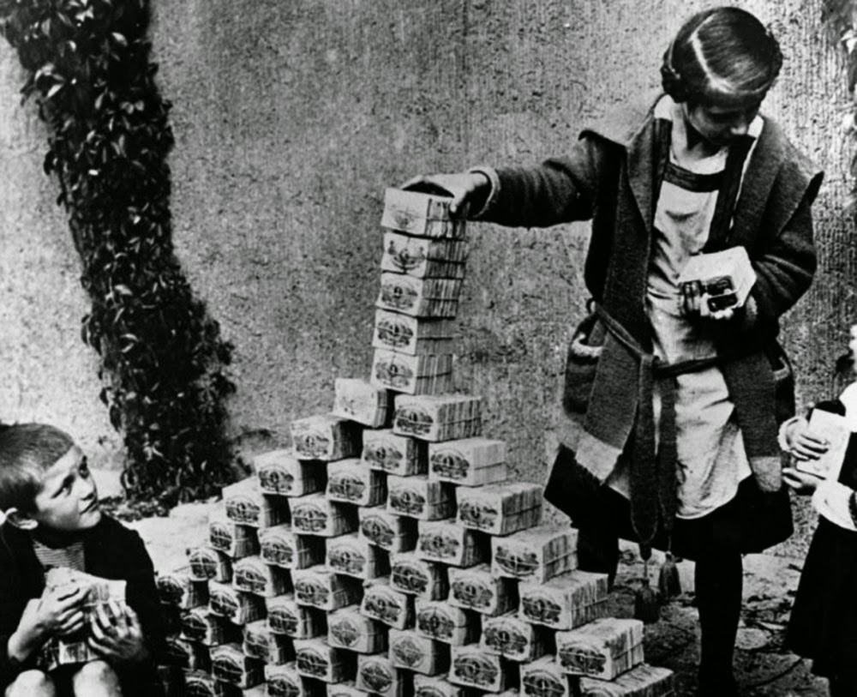
The German economy fails… twice
War reparations ruined the German economy
By 1923 hyperinflation was so bad that paper money became worthless. Many middle-class families lost their savings.
The Great Depression hit in 1929 and by 1932 30% of German workers were unemployed

Slide 5
Hitler’s rise to power
In 1920 Hitler takes control of a small political party called the National Socialist German Workers (Nazi) party.
In Nov. 1923, he tried to seize control of the Bavarian government but failed and was jailed.
1930 - Hitler’s party was able to take advantage of people’s desperation for a stronger economy and won a million votes and 107 seats. This meant that it was the now the second largest political party in Germany.
1933 - Hitler was able to take over the Government as the “Fuhrer” (leader) and abolish democracy in Germany.

Slide 6
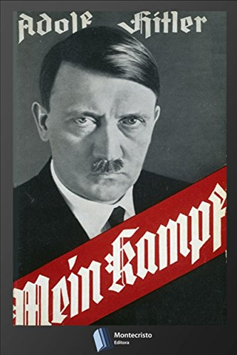
Mein Kampf
While in jail Hitler wrote, Mein Kampf (My Struggle) in which he set out his goals for the German nation.
Aryans (blond, blue-eyed Germans) were a master race destined to rule over inferior races
Create more lebensraum (living space) for the German people by removing non-Germans (especially Jews) and expanding Germany’s territory through war.
Demanded Anchluss, the reunification of Austria and Germany
Outlined his plans to conquer Eastern Europe.

Slide 7
Violations of the Treaty of Versailles
German rearmament (1935). Creates an Air Force and announces plans for military conscription
Hitler and Soviet Russia invade Poland (1939).
Each of these changes put Germany in a stronger position to wage war in Europe.
Hitler takes over and re-militarizes the Rhineland (the industrial heart of Germany)
Hitler invades the Sudetenland (1938) then the rest of Czechoslovakia (1939) in order to “liberate” Germans who are living there.
Hitler invades of Austria (March 12, 1938).

Slide 8
Policy of Appeasement
The Munich Agreement (September, 1938): Leaders of the Allies agree that Hitler can have the Sudetenland only if he promises to stop all demands for more territory.
Hitler agreed, but 6 months later Hitler breaks the agreement, and invades the rest of Czechoslovakia.
Pro Appeasement: Some argue that Appeasement was a strategy to allow the allies to re-arm in order to better fight Germany.
Neville Chamberlain (British PM) and Mackenzie King (Canadian PM) both believed that Hitler was a reasonable man. They believed he could be appeased with diplomacy.

Slide 9
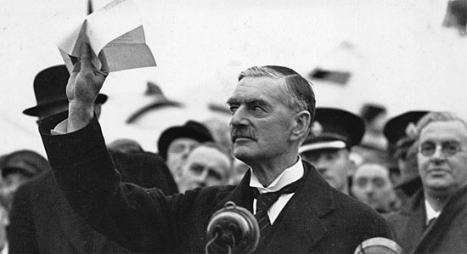
Chamberlain: “peace in our time” (1938)

Slide 10
Policy of Appeasement cont’d
Hitler promised to oppose Stalin’s Russia. For that reason, Britain and the other allies wanted to remain friendly with Germany.
Anti-appeasement: Others believe that appeasement was a failed strategy that only fed Hitler’s confidence and pushed the world toward war.
After the outbreak of War, British PM Neville Chamberlain was criticized for failing to oppose Hitler. He resigned, and was replaced by Sir Winston Churchill.

Slide 11
Nazi-Soviet Non-Aggression Pact (1939)
Hitler and Stalin despised and feared one another. Hitler decides to create peaceful relations with the USSR so that he doesn’t have to fight a two-front war and can focus on conquering Western Europe.
They decide to BOTH invade and split up Poland and not attack each other in the process.
Because the USSR promises not to interfere with Hitler’s ambitions, Hitler becomes more confident and aggressive, which pushes Germany towards war.

Slide 12
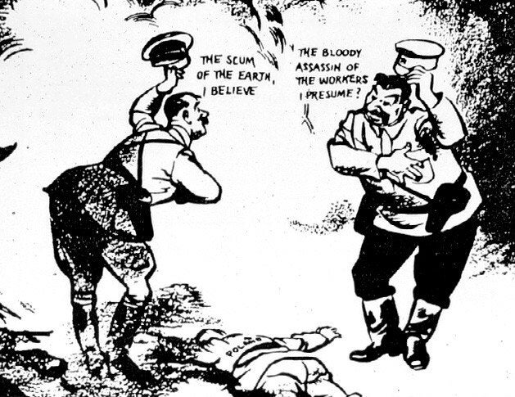

Slide 13
Invasion of Poland (September 1, 1939)
After WW1, territory was taken from Russia and Germany to create the country of Poland. Hitler and Stalin agreed to divide Poland between them and take back this land in 1939.
The German “Blitzkrieg” surprised and defeated the Polish military.
As they had promised to support Poland against invasion, Britain and France declared war on Germany on September 3, 1939. Canada followed suit on September 10.
What followed as a “phoney war” as the allies didn’t directly engage Germany militarily until May, 1940 when Hitler invaded France.

